Slide 1
Interpretability Project

Slide 2
Dataset info:
The dataset we are working on is related to the heart disease, it consists of 11 columns, which are the diagnosis of the patient, and the 12 column is the target, which specify whether the patient has a heart disease or not.
The dataset is considered to be a classification problem, because based on the features columns we need to know the target column.
The dataset has no nulls.
The rows are 1190.

Slide 3
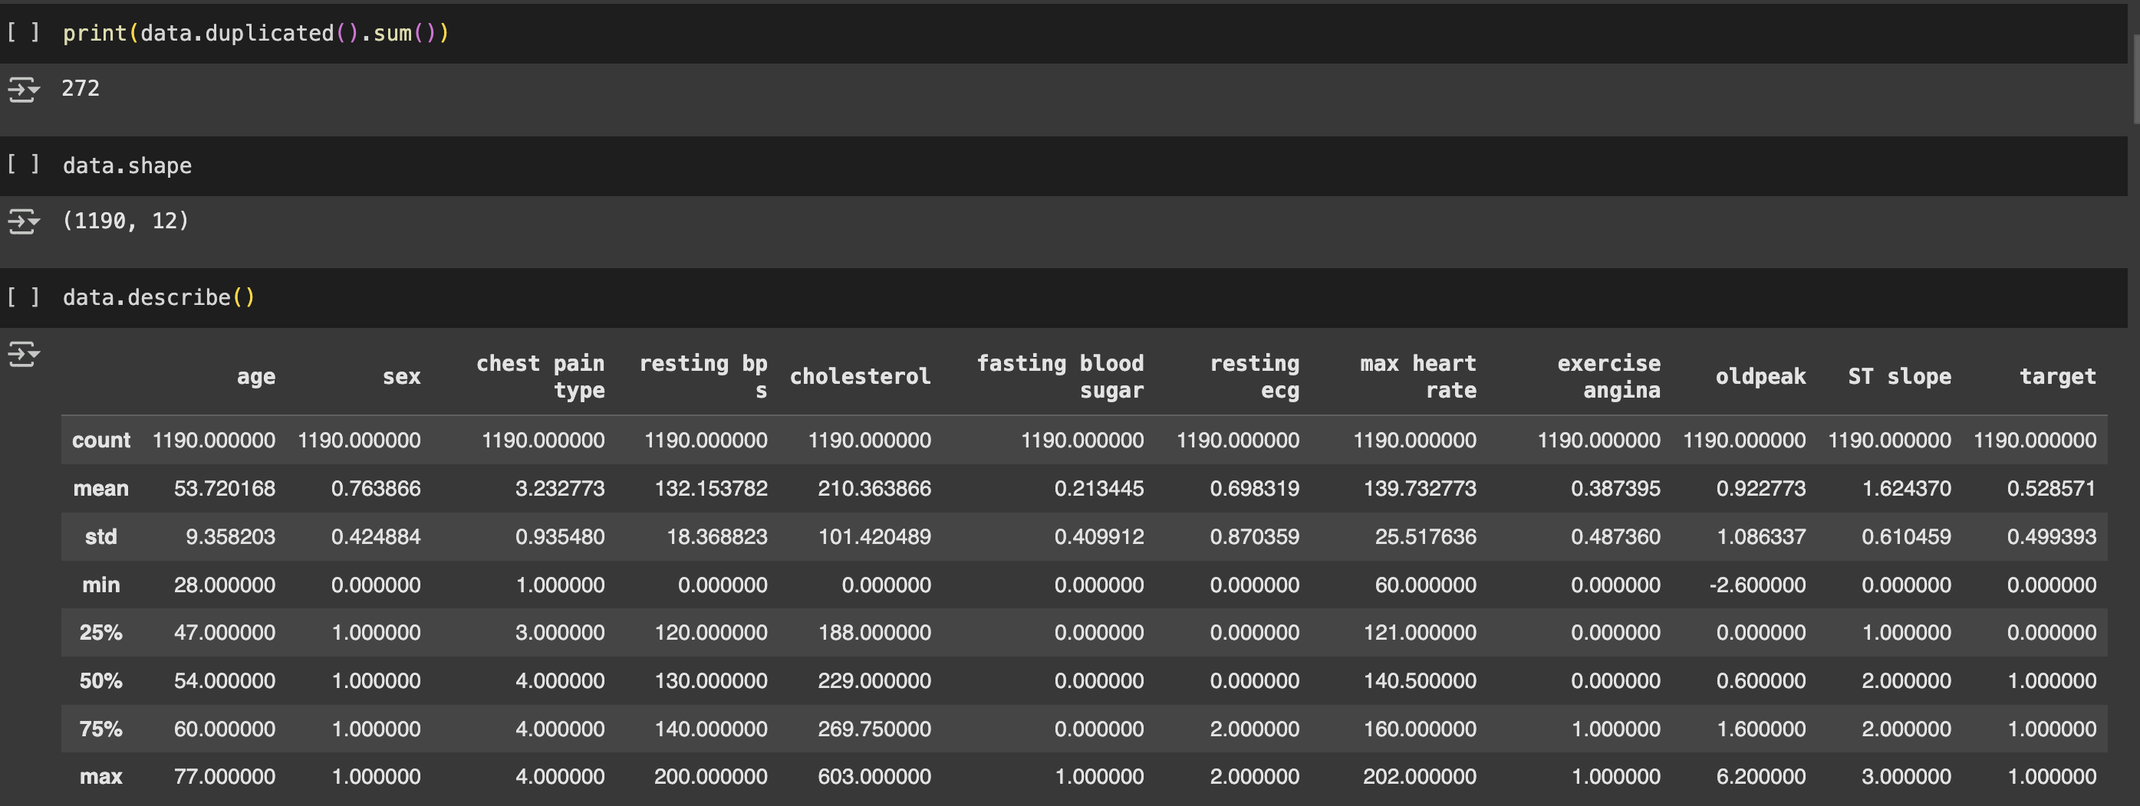
Here is a quick brief of our dataset:

Slide 4
The dataset were trained on all the features with dropping the target column, as it is the column that needs to be determined.
We will demonstrate the EDA we applied in the next slides.

Slide 5
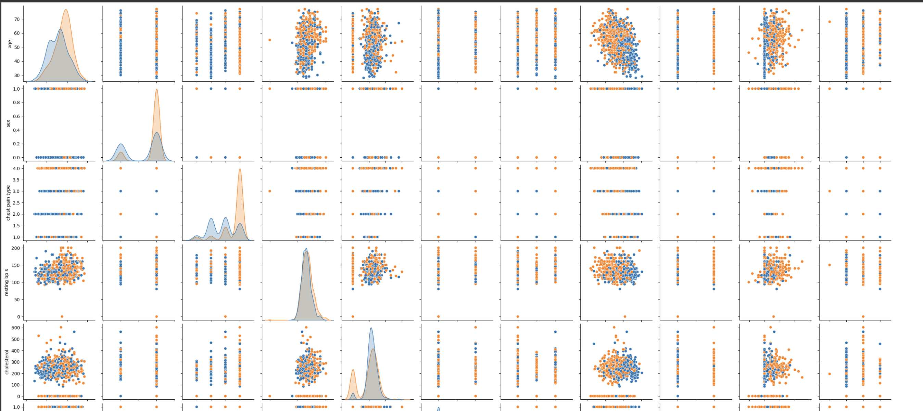
PairPlot:

Slide 6
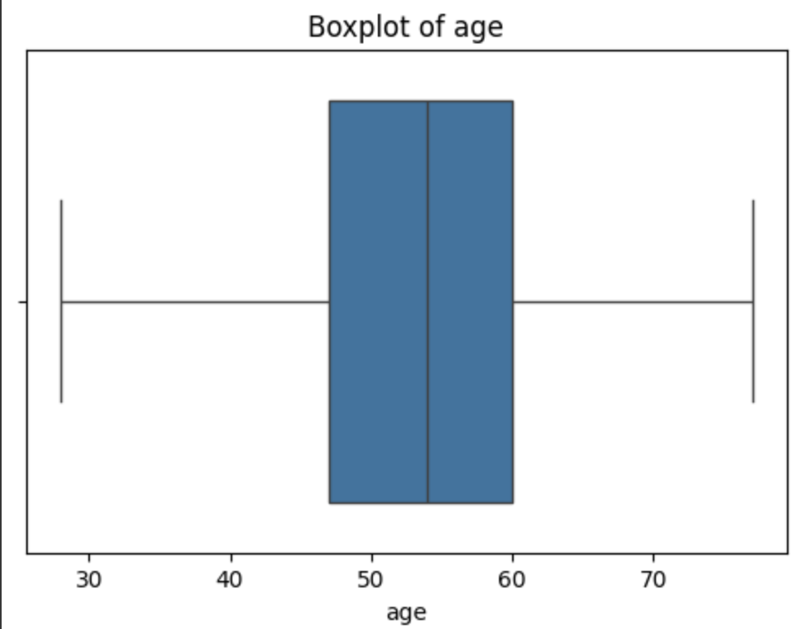
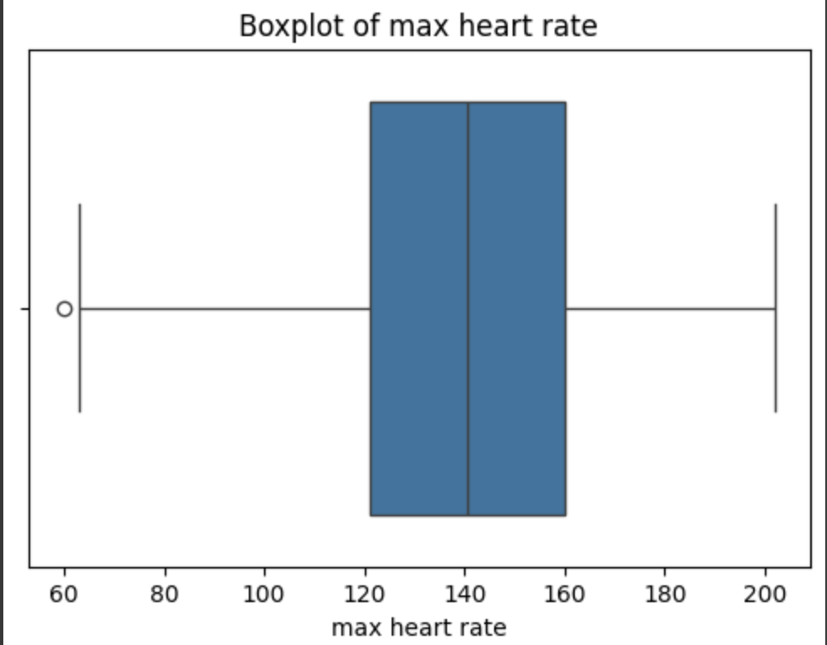
BoxPlots:

Slide 7
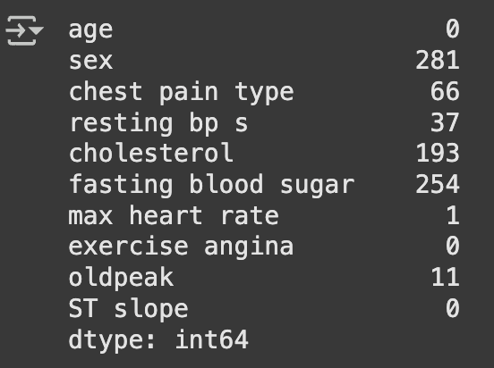
Outliers:

Slide 8
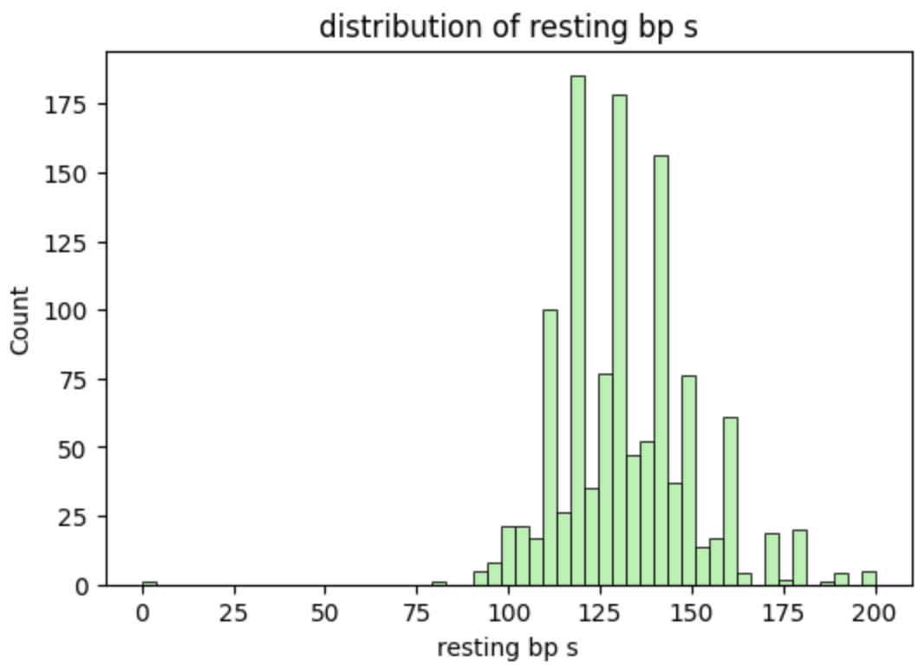
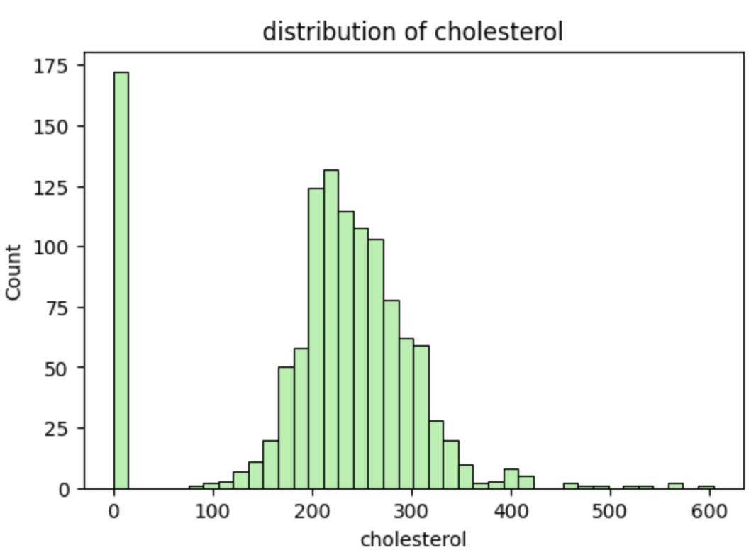
Histogram:

Slide 9
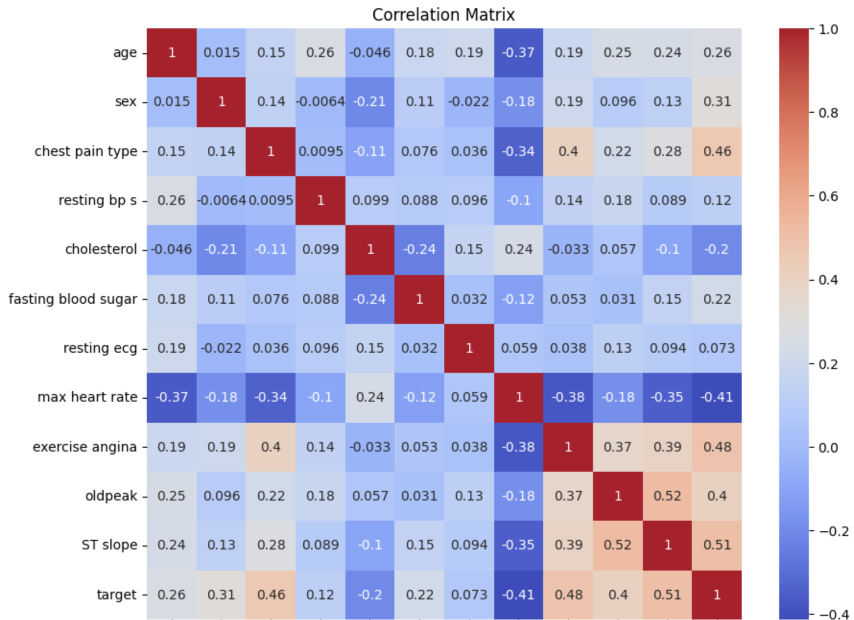
Correlation Matrix:

Slide 10
Models:

Slide 11
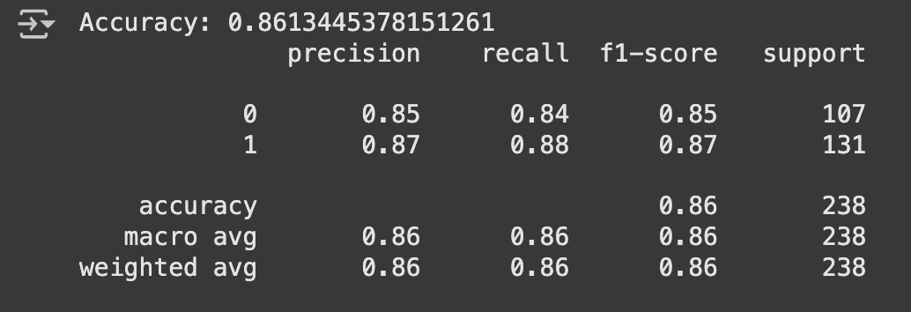
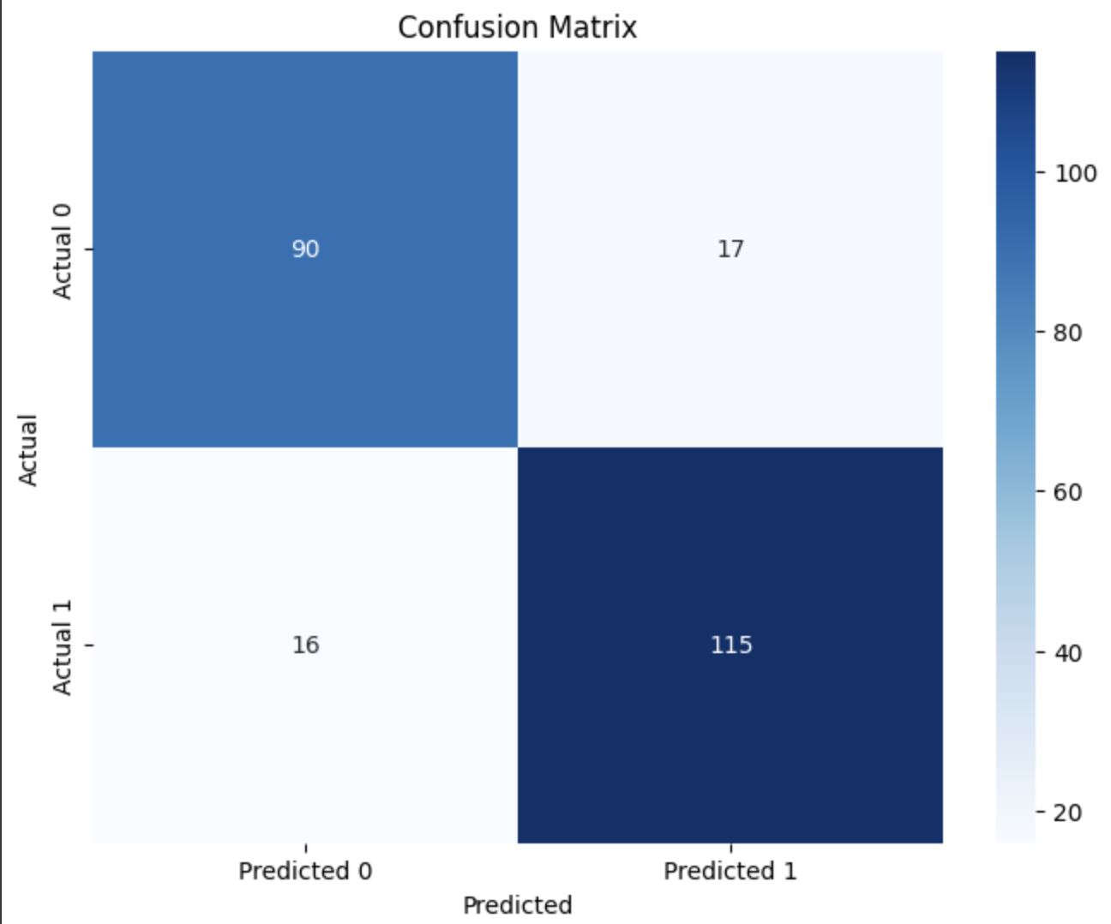
1- Logistic Regression

Slide 12
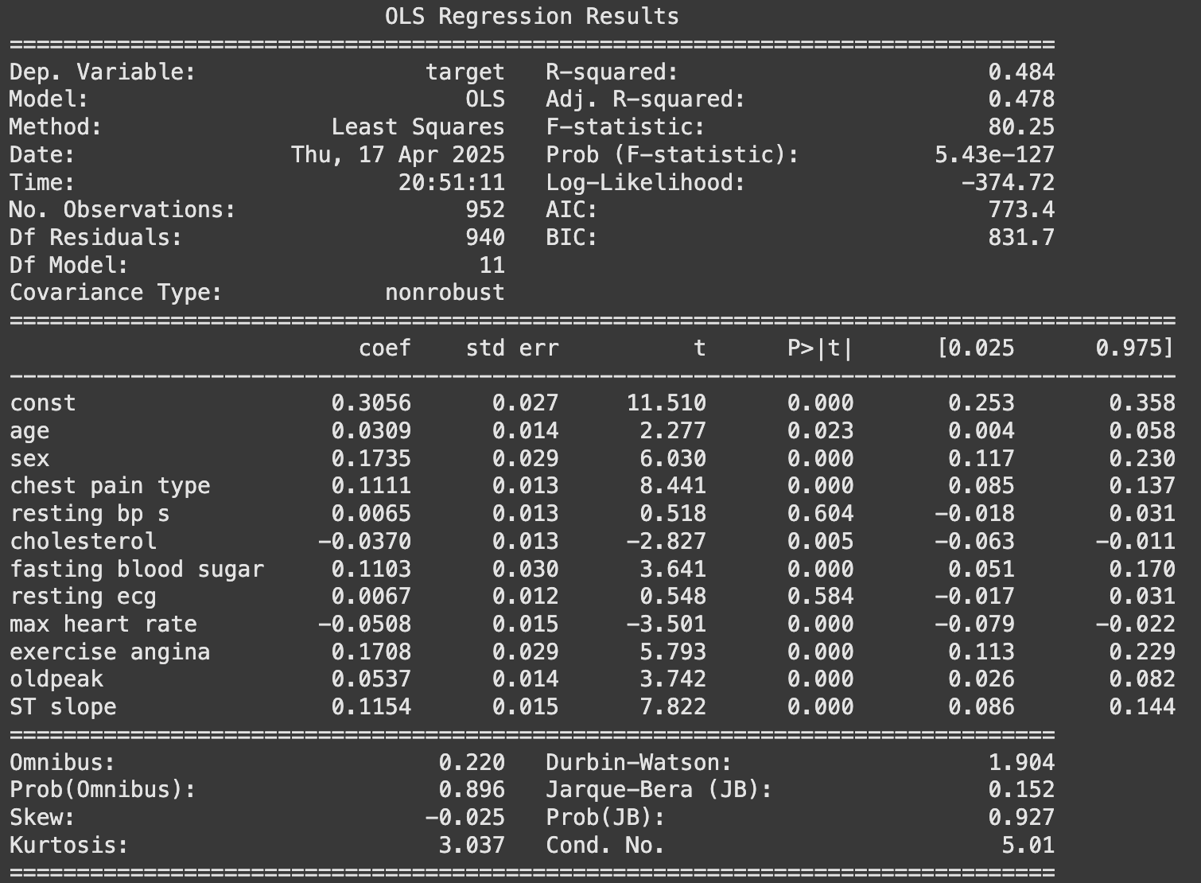
Linearity Assumption:

Slide 13
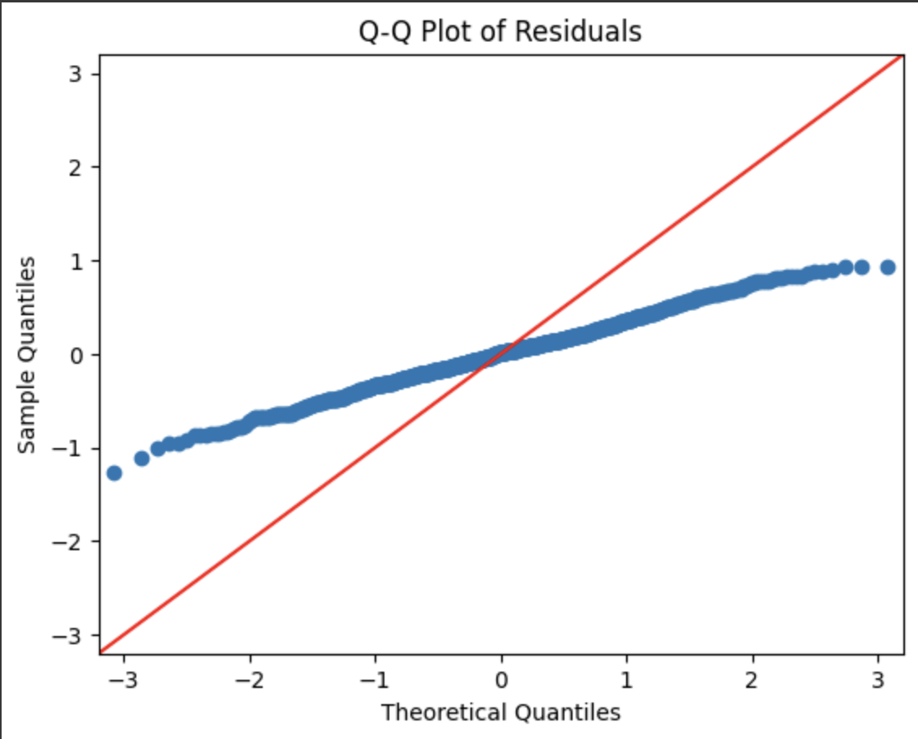
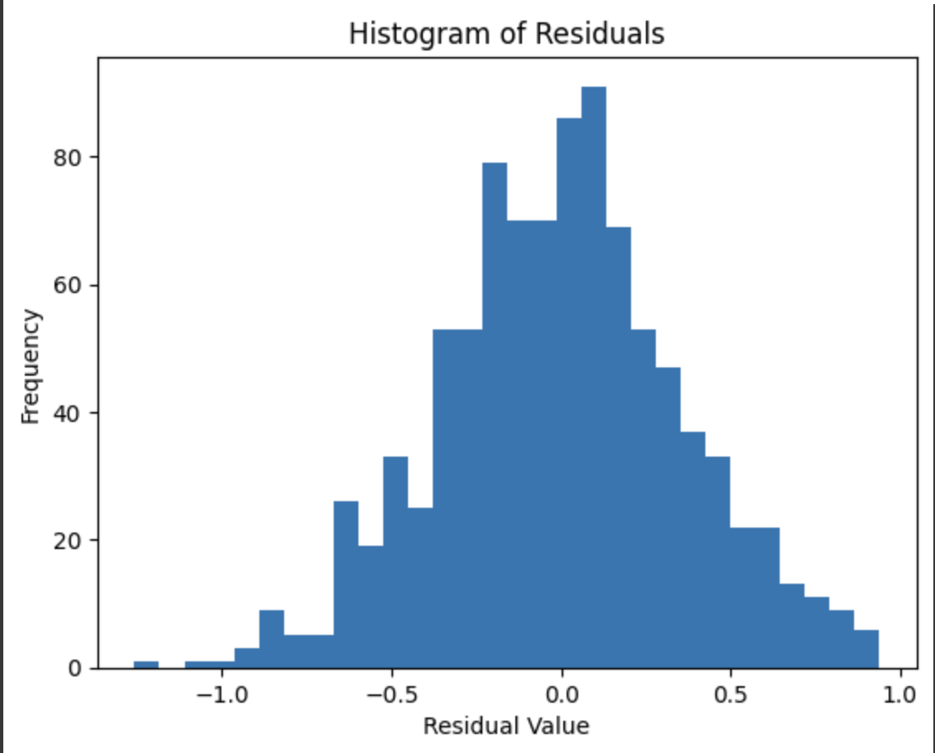
Mormal Distribution of Risdulas:

Slide 14
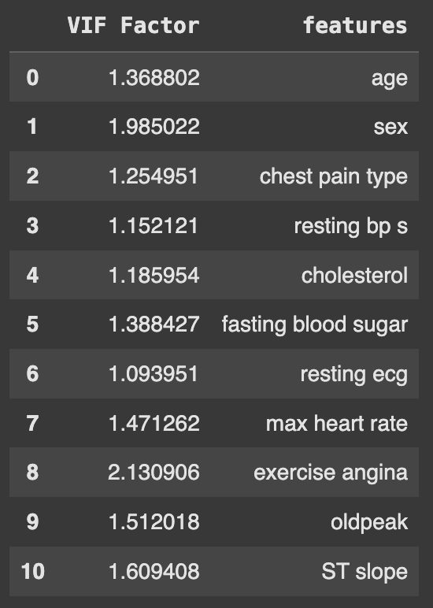
VIF:

Slide 15

Variables Correlation:

Slide 16
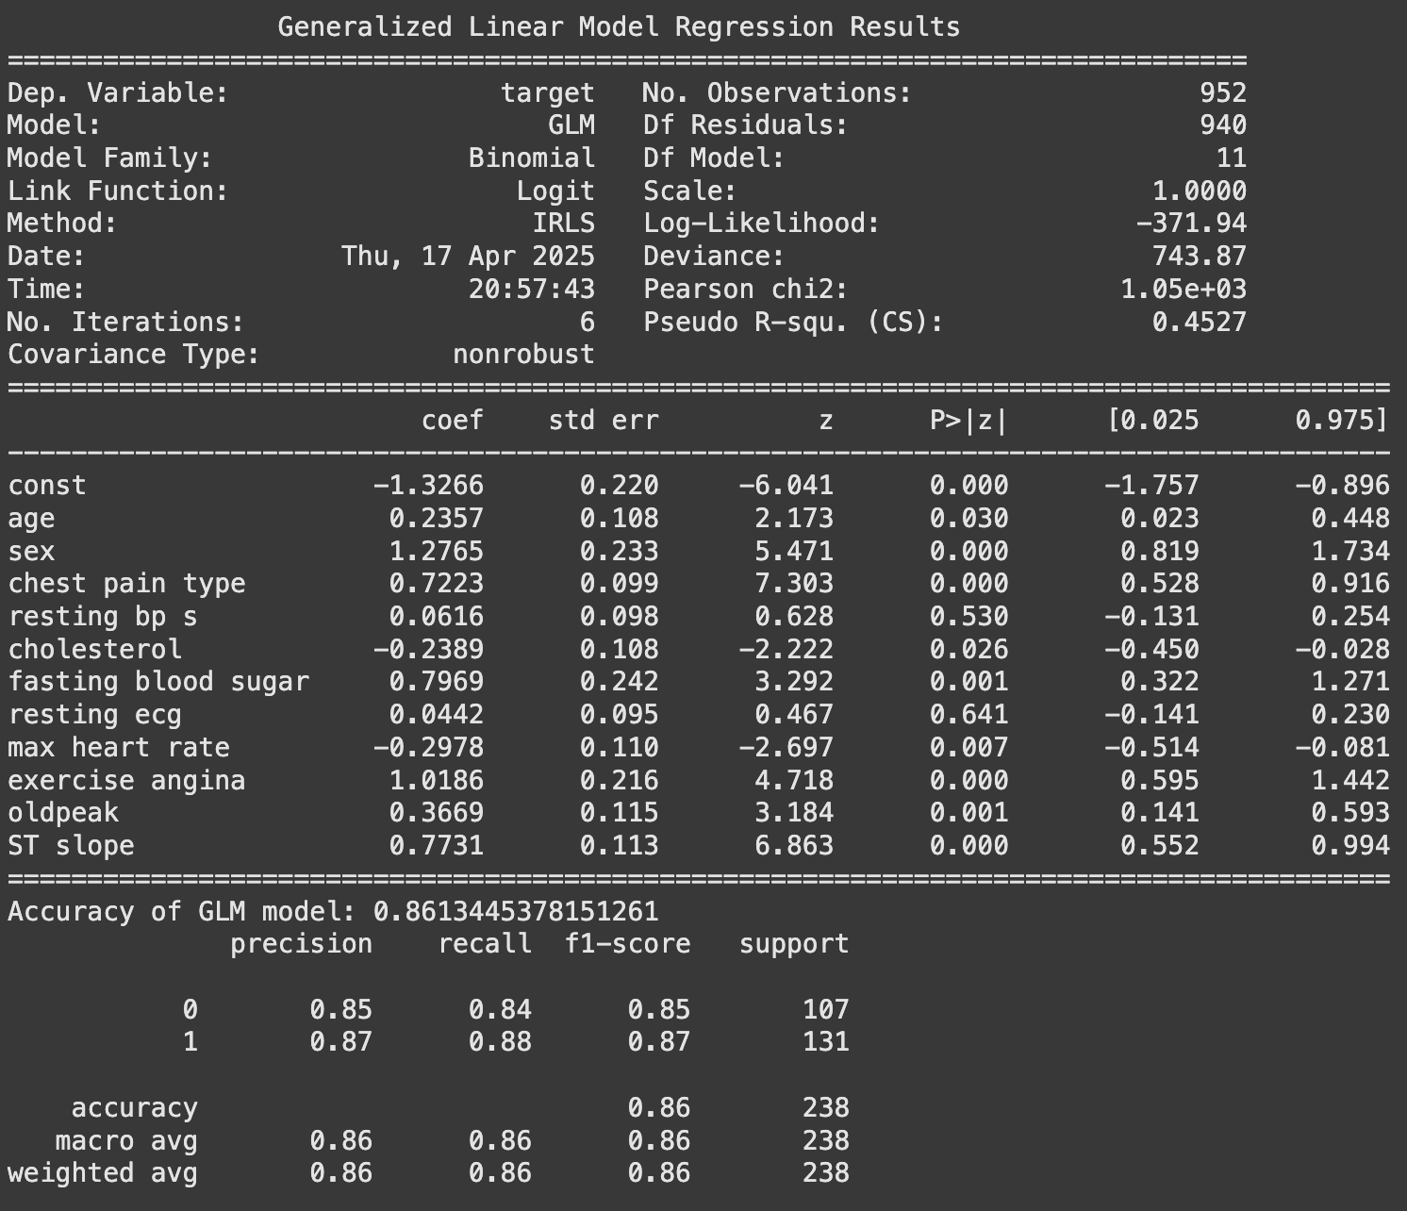
GLM:

Slide 17
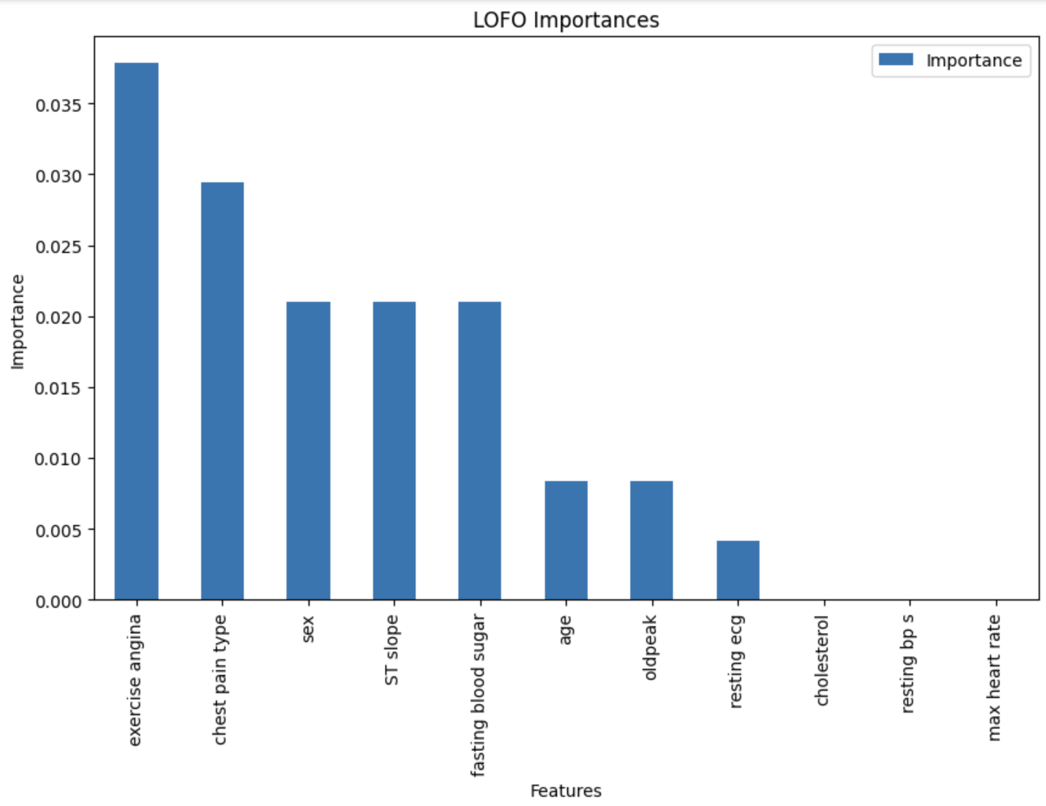
LOFO:

Slide 18
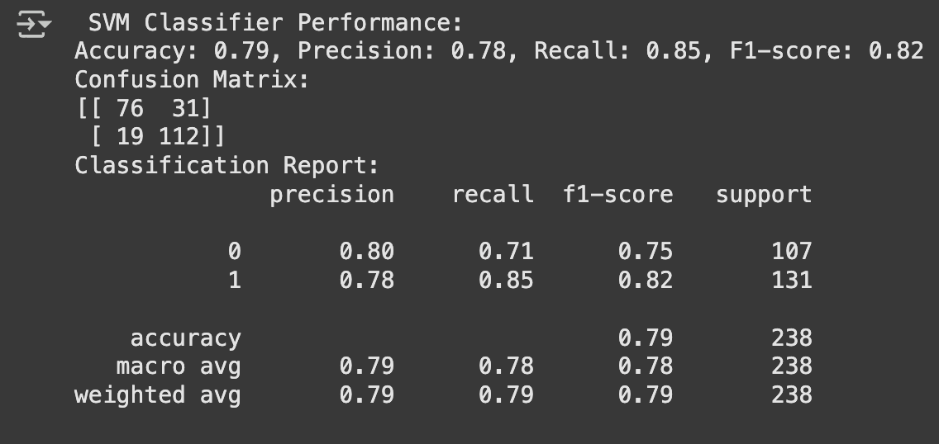
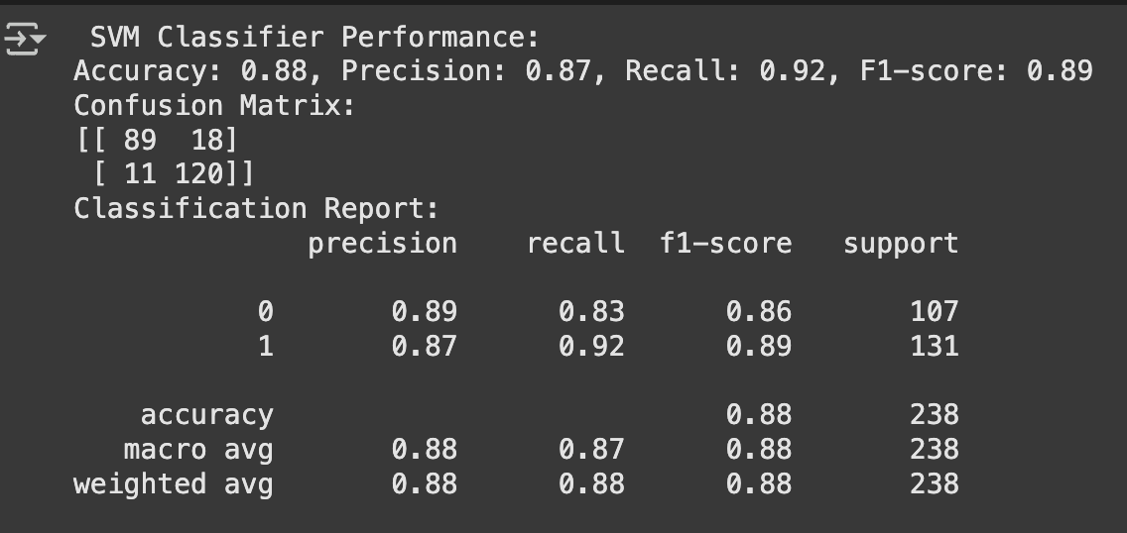
2- SVC, and SVC using rbf kernel

Slide 19
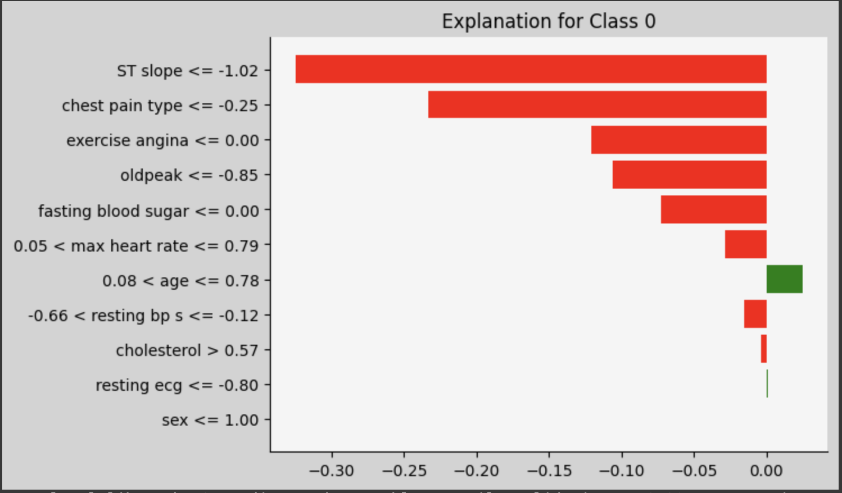
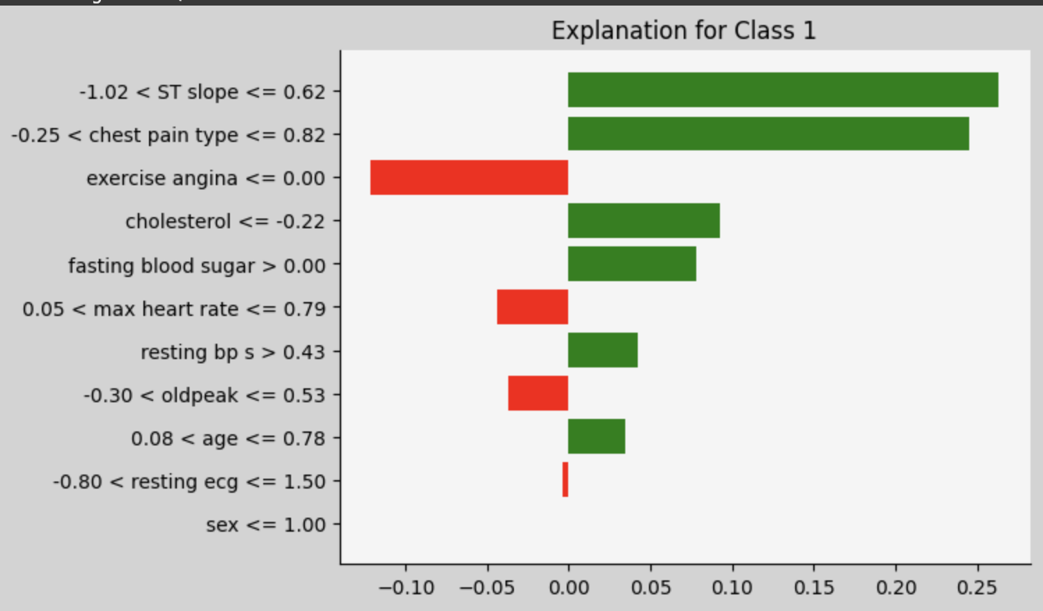
LIME:

Slide 20
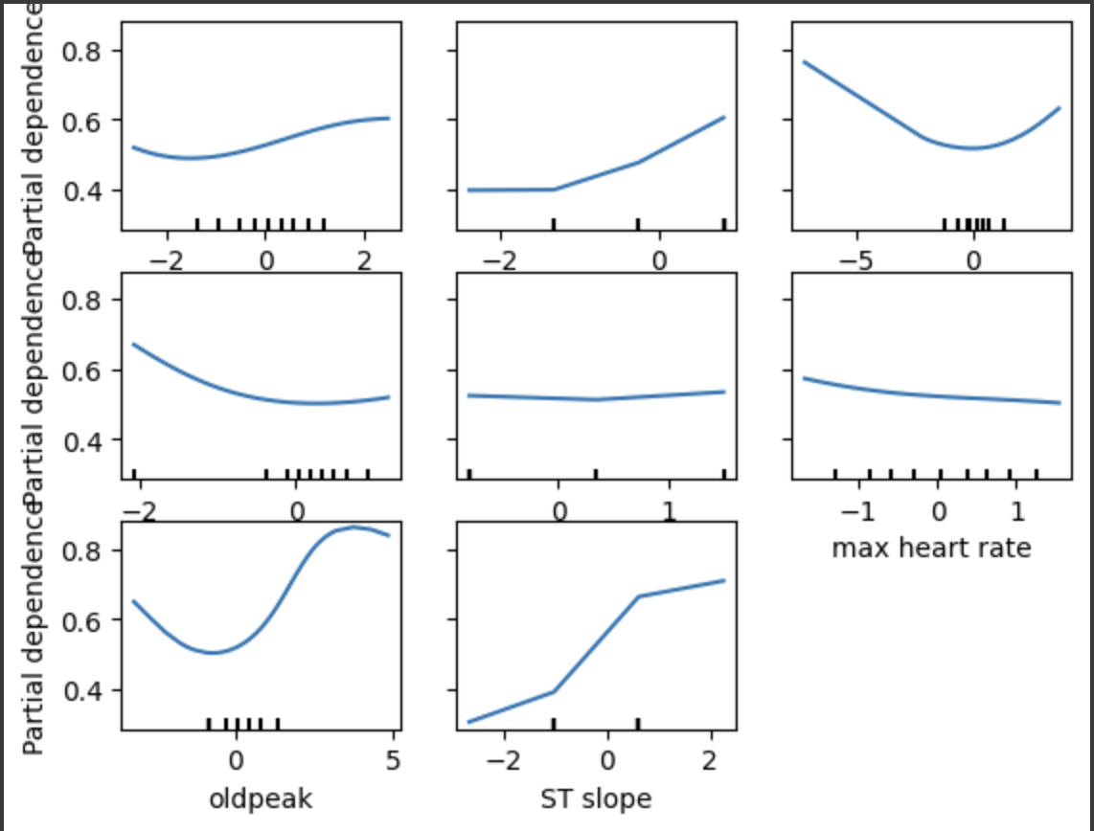
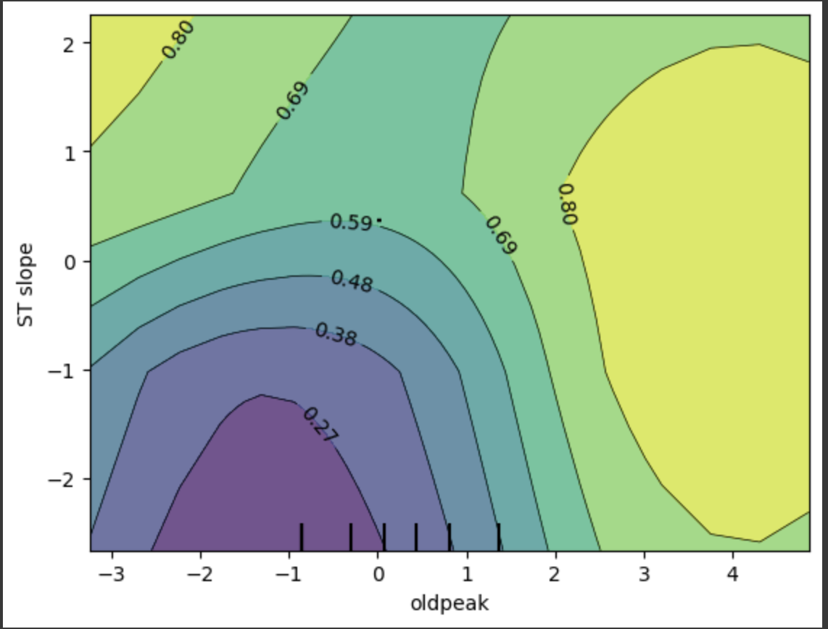
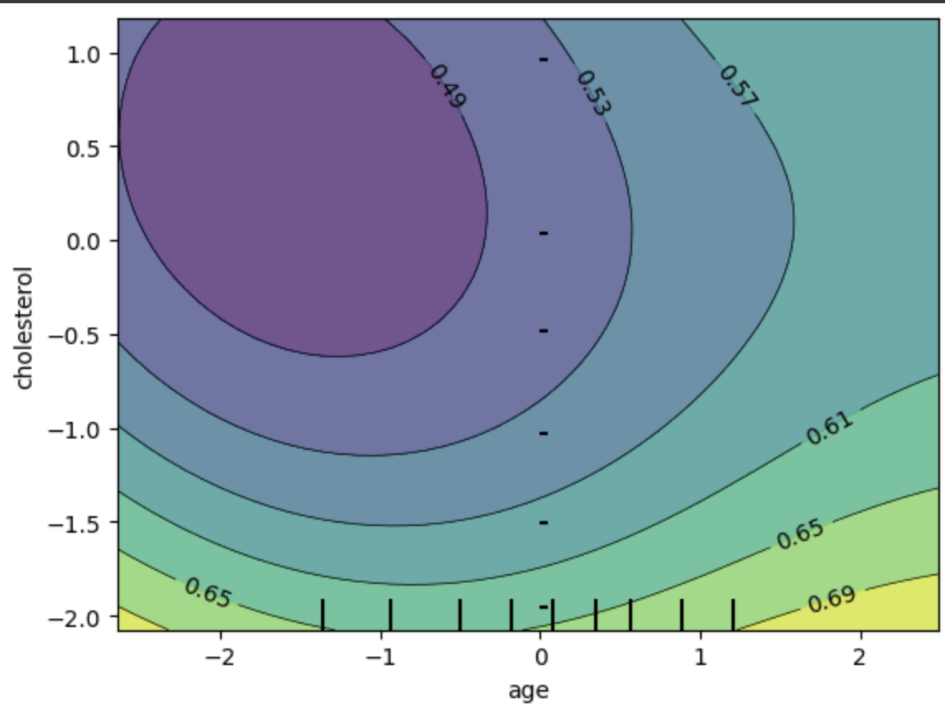
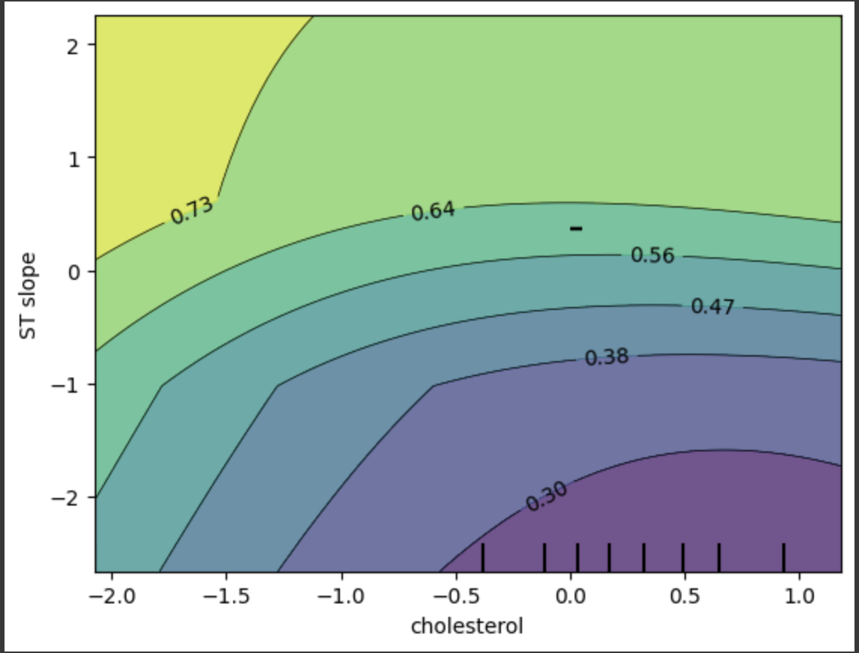
PDP:

Slide 21
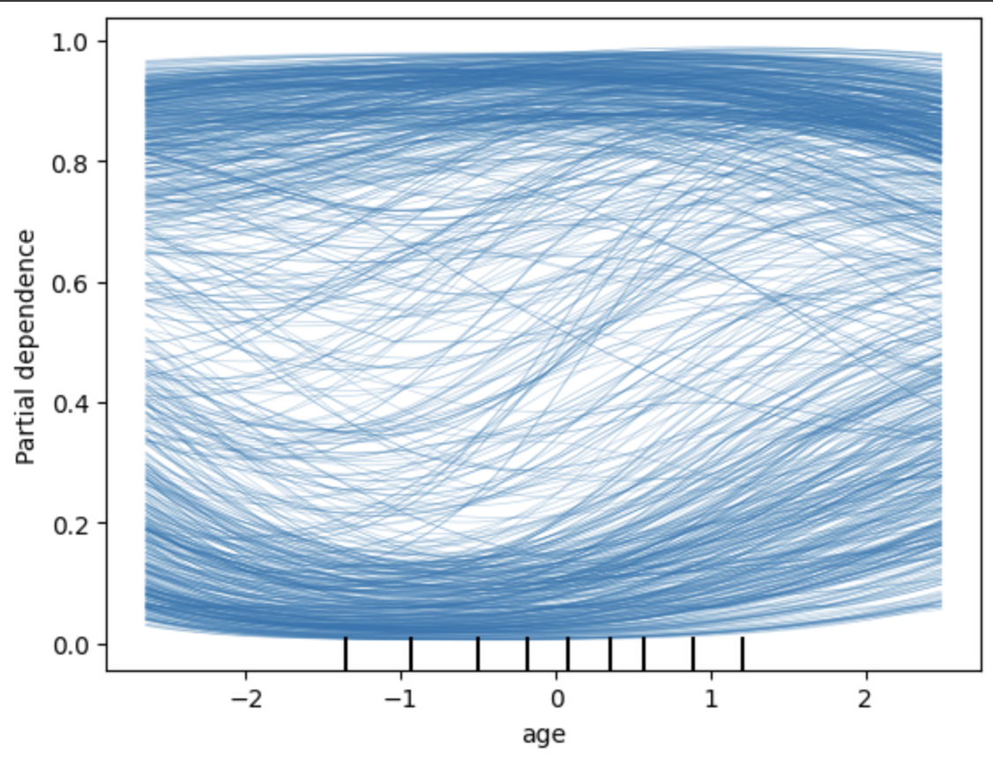
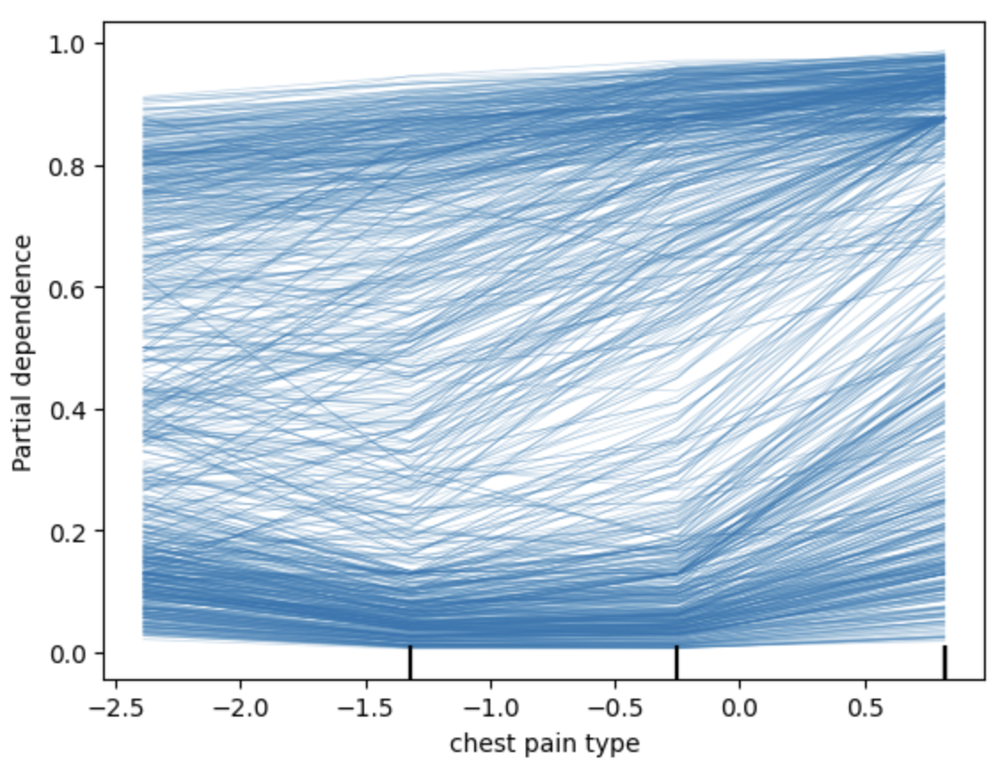
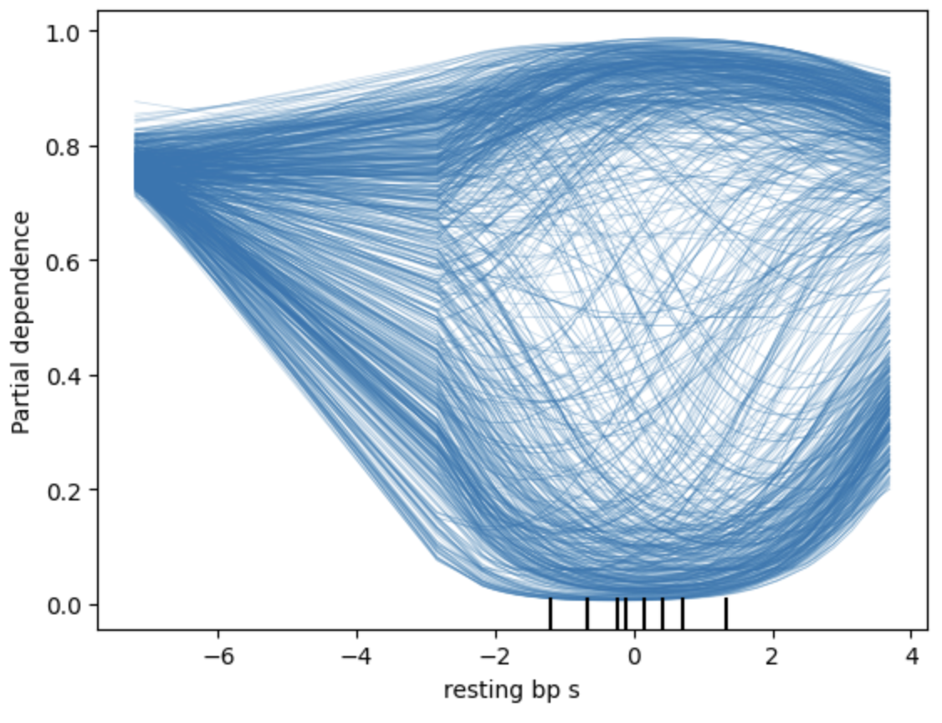
ICE:

Slide 22
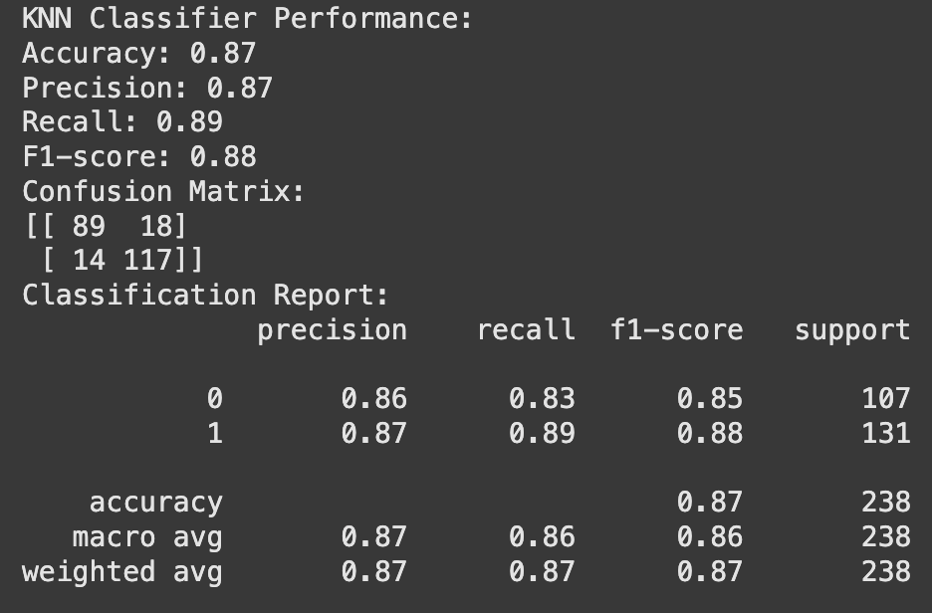
3- KNN

Slide 23
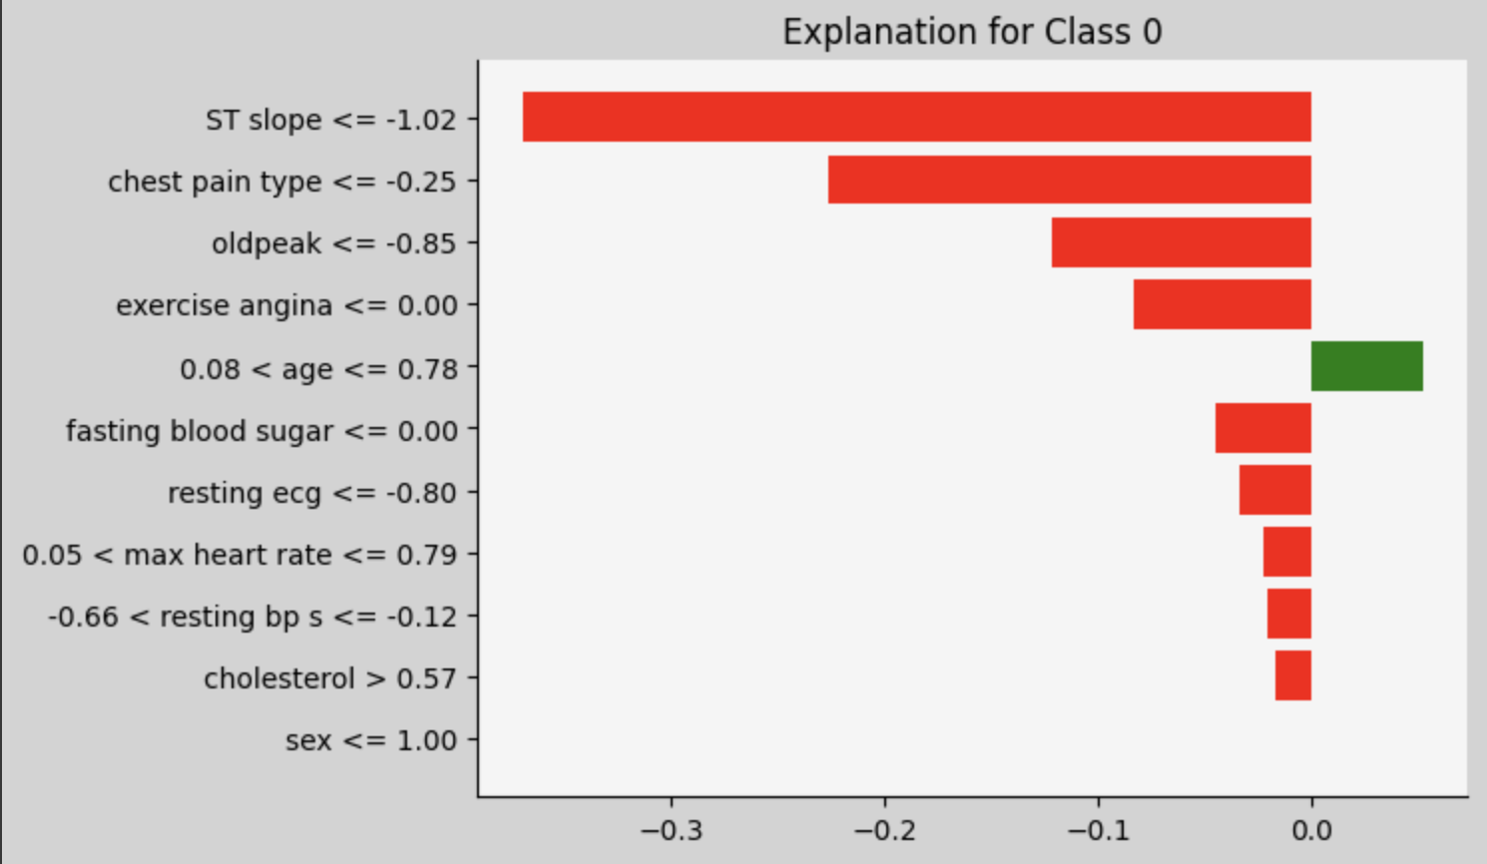
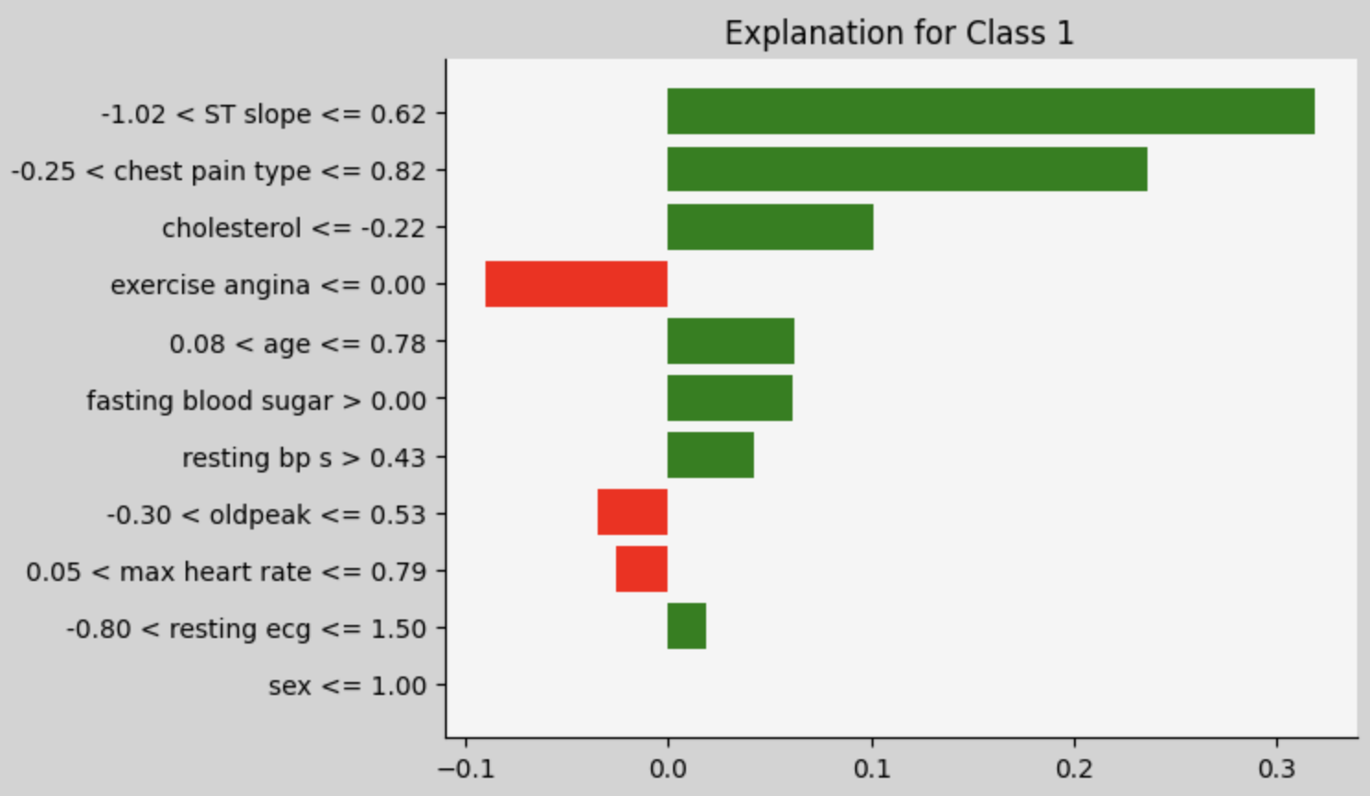
LIME:

Slide 24
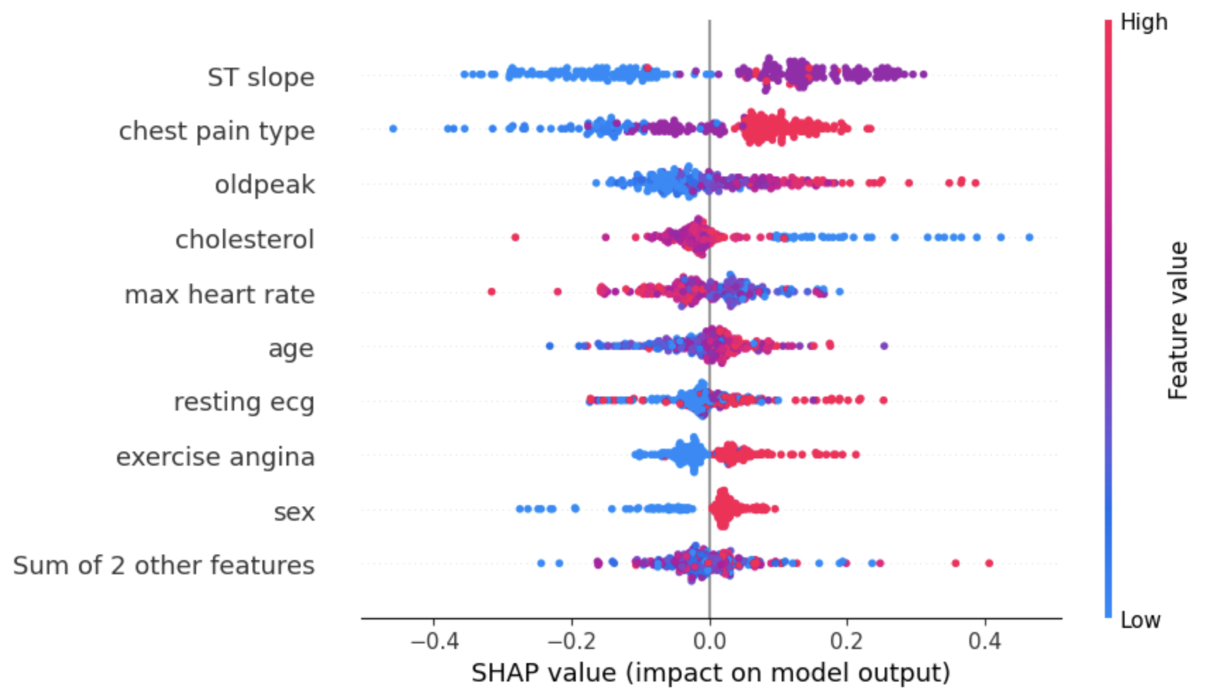
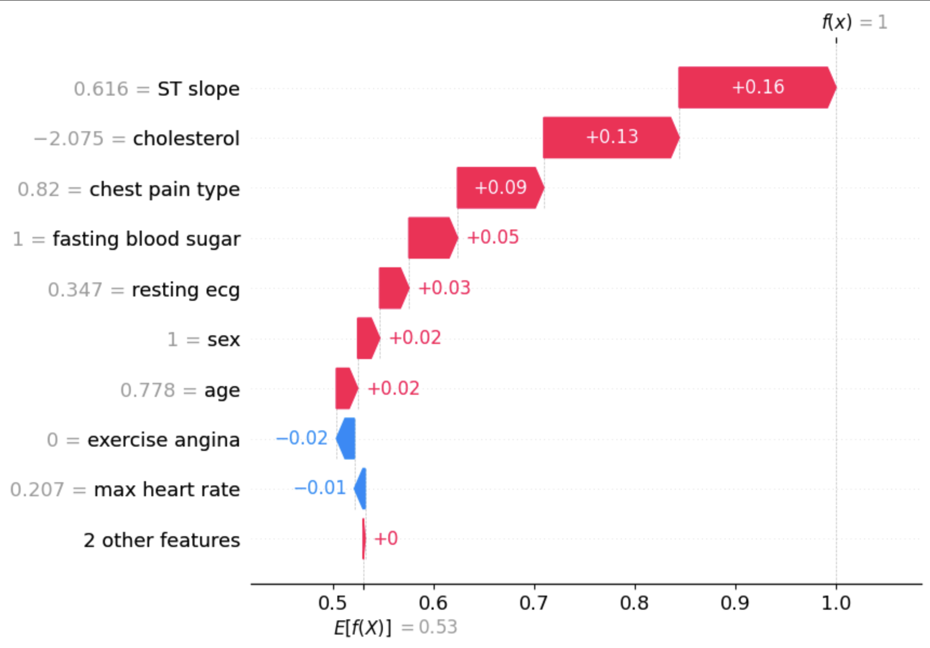
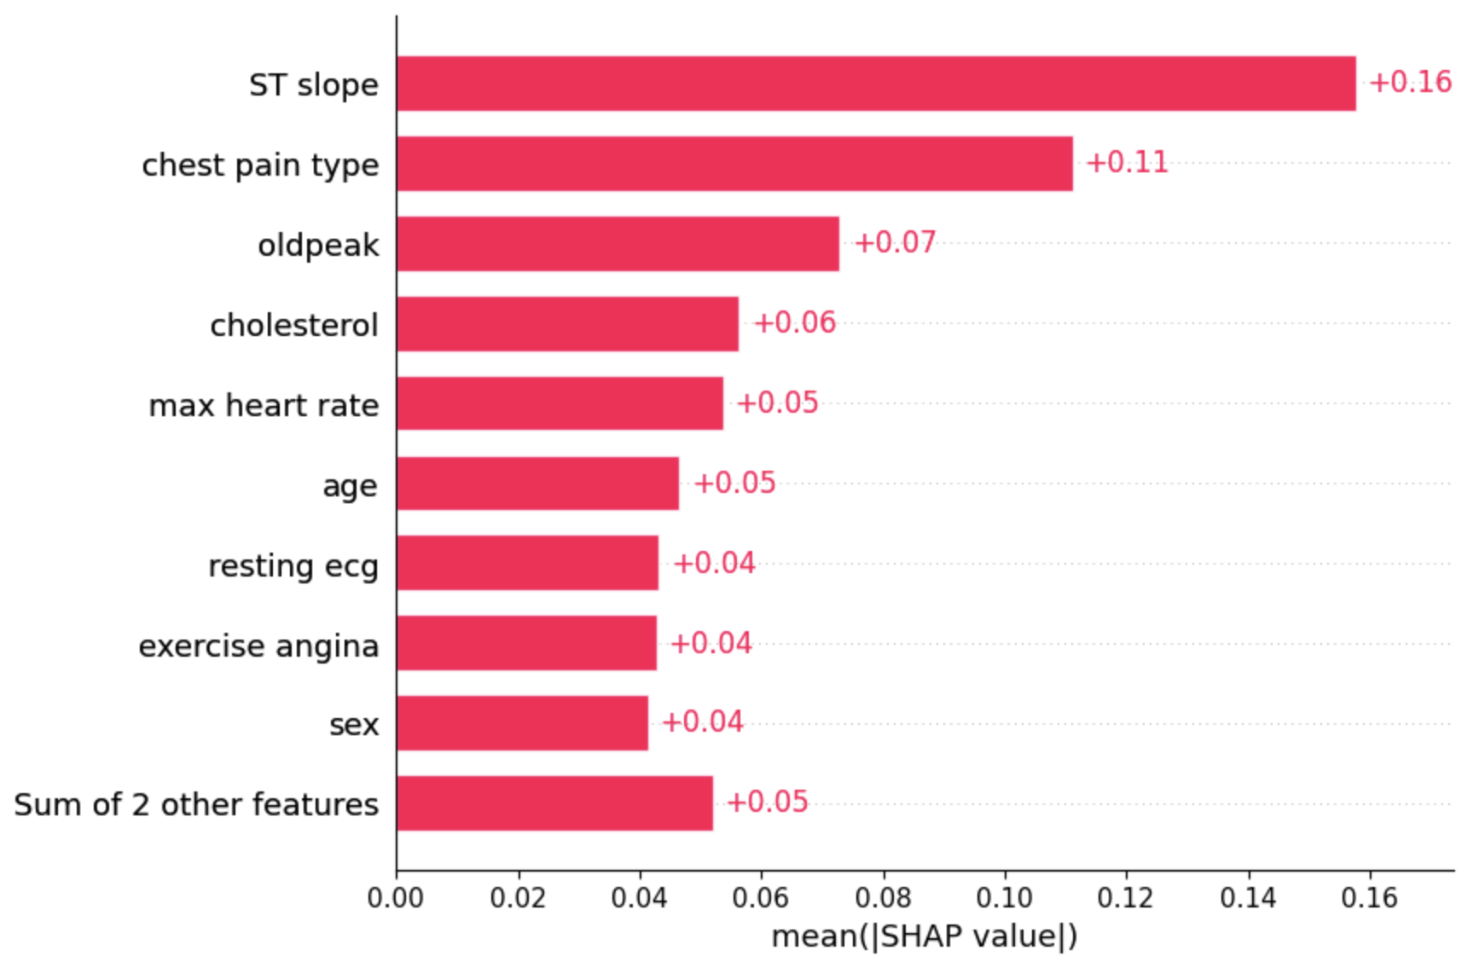
SHAP:

Slide 25
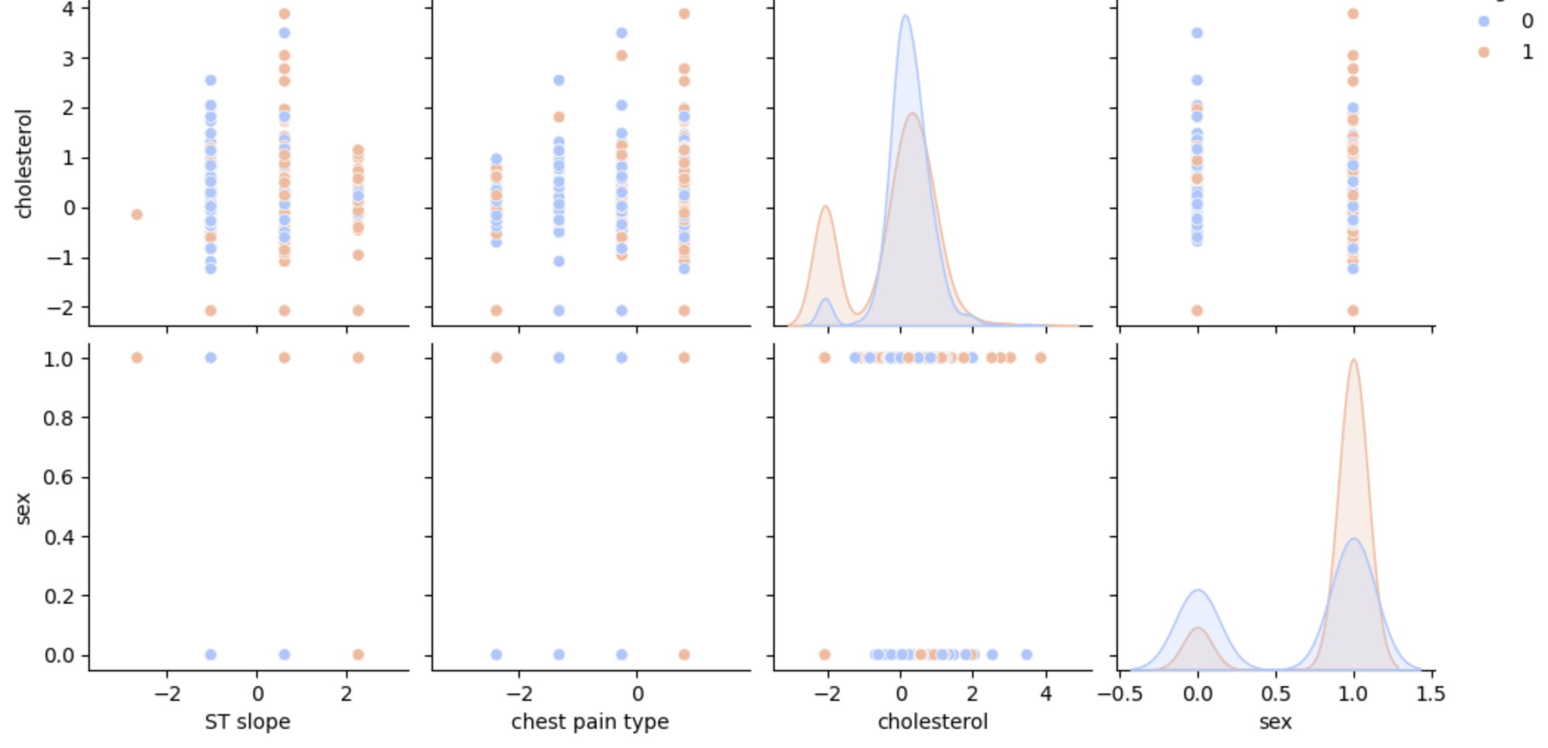
PairPlot:

Slide 26
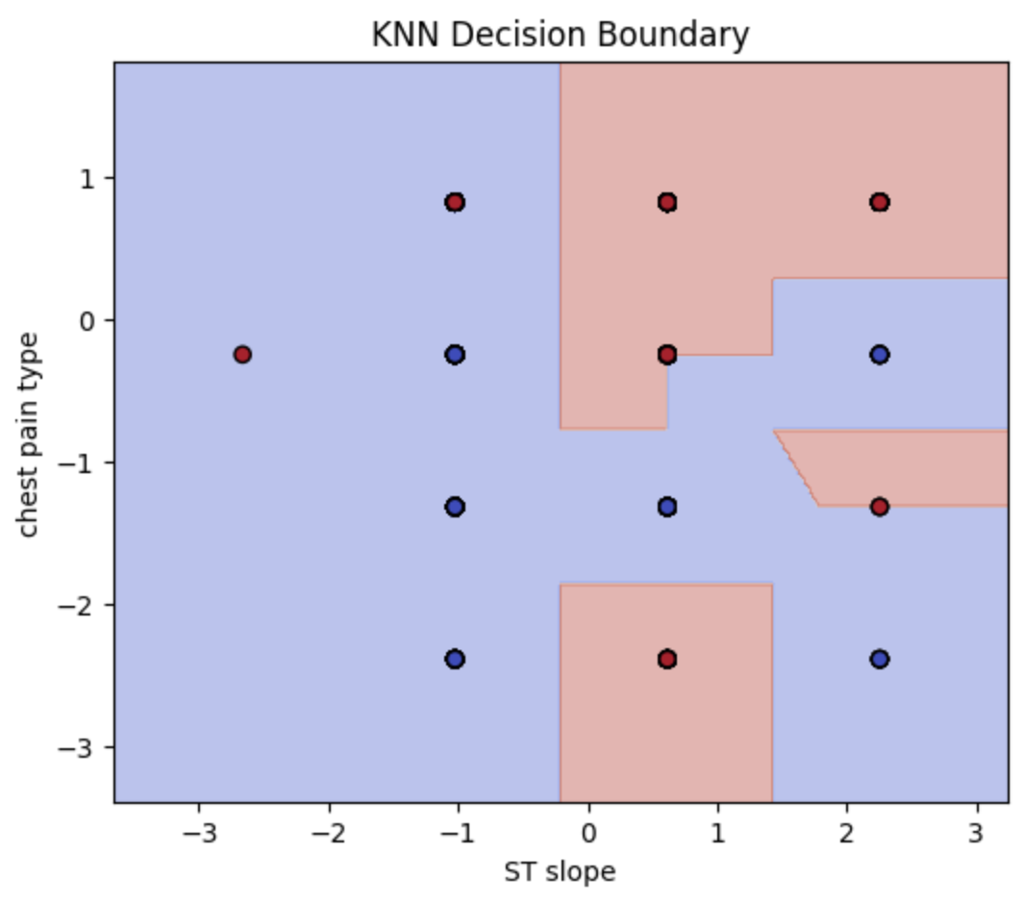
Decision Boundary:

Slide 27
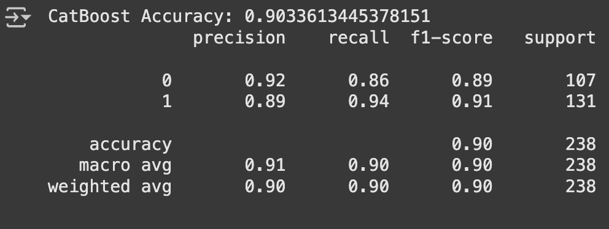
4- CatBoost

Slide 28
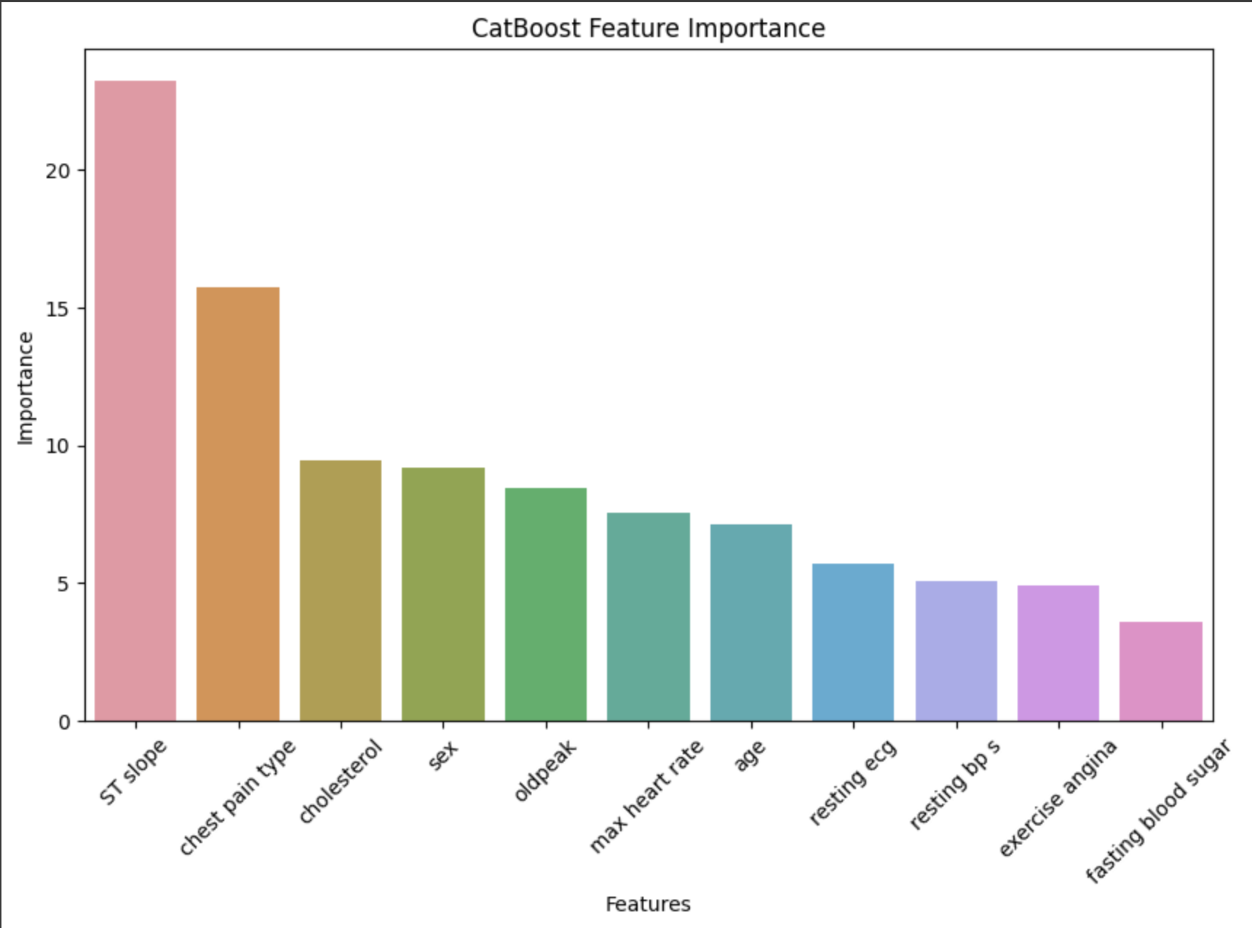
Feature Importance:

Slide 29
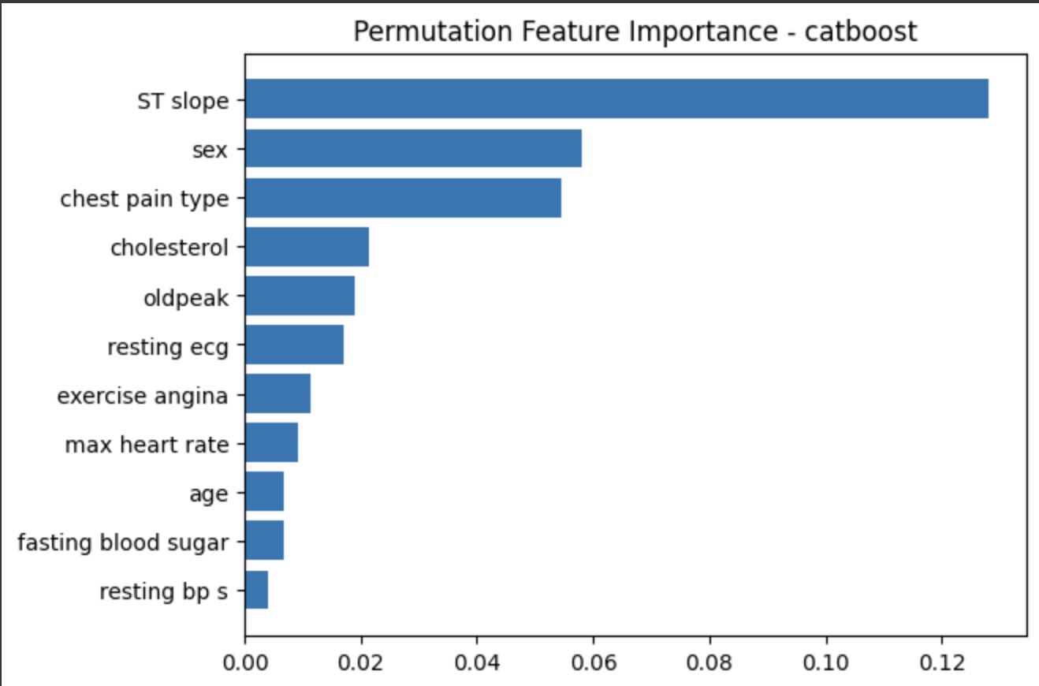
Permutation Feature Importance:

Slide 30
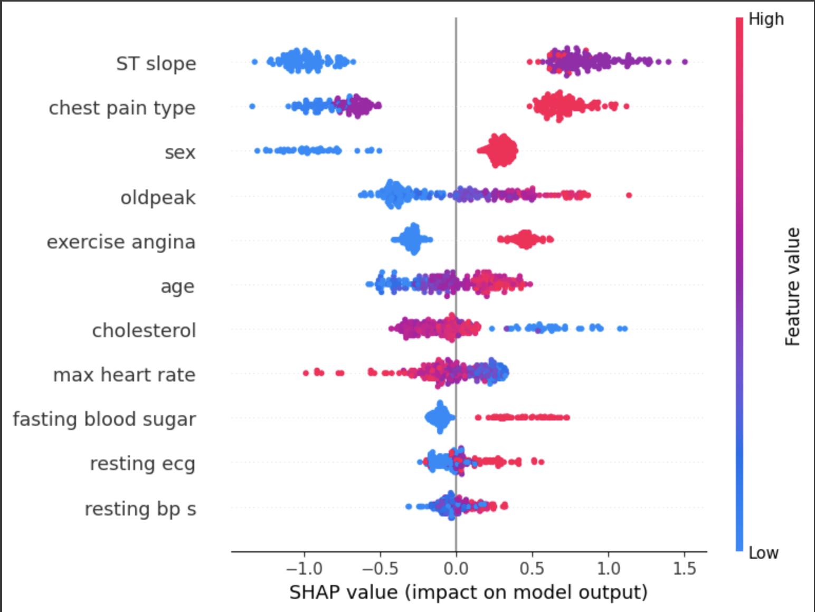
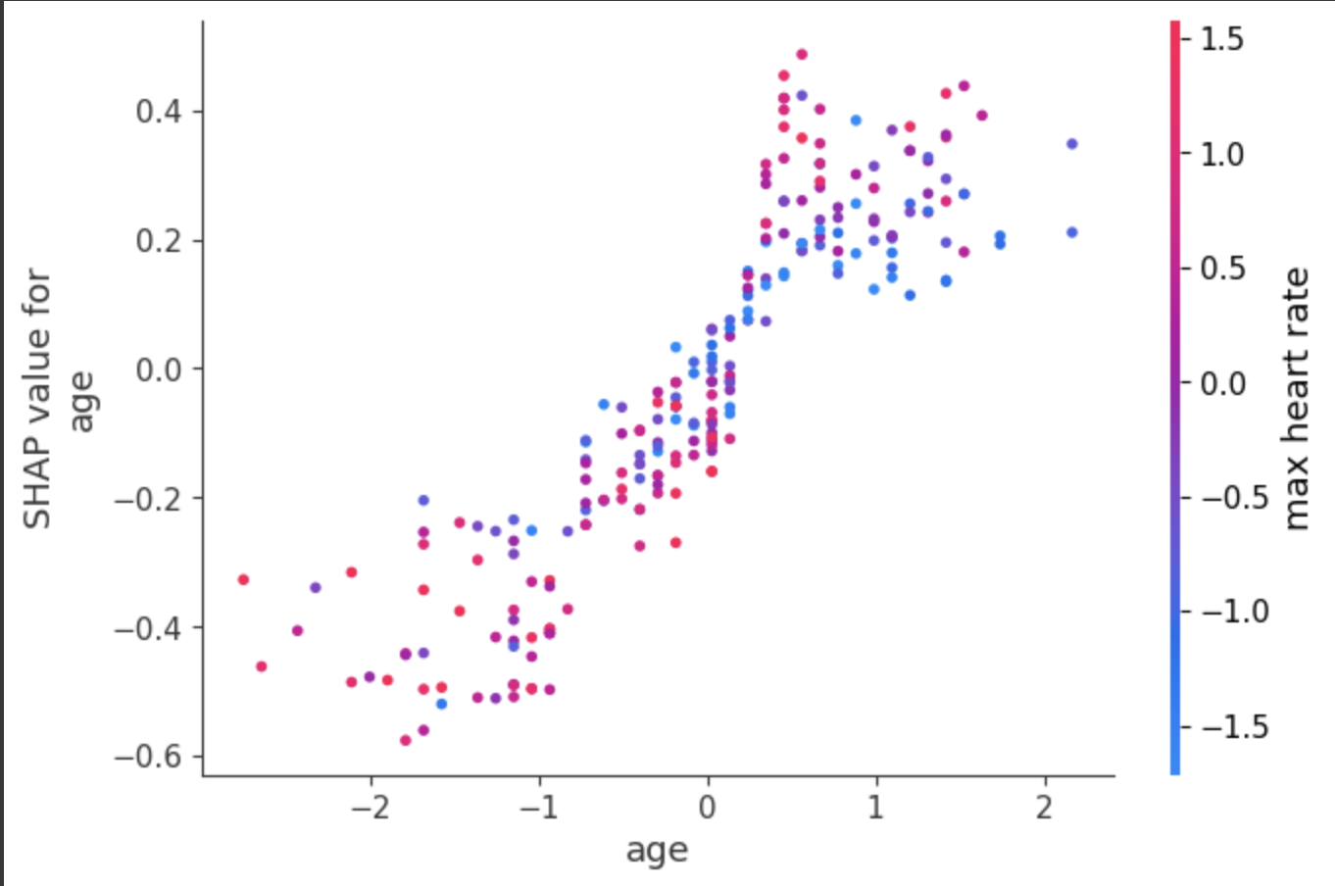
SHAP
(Summary plot): (Dependance plot):

Slide 31
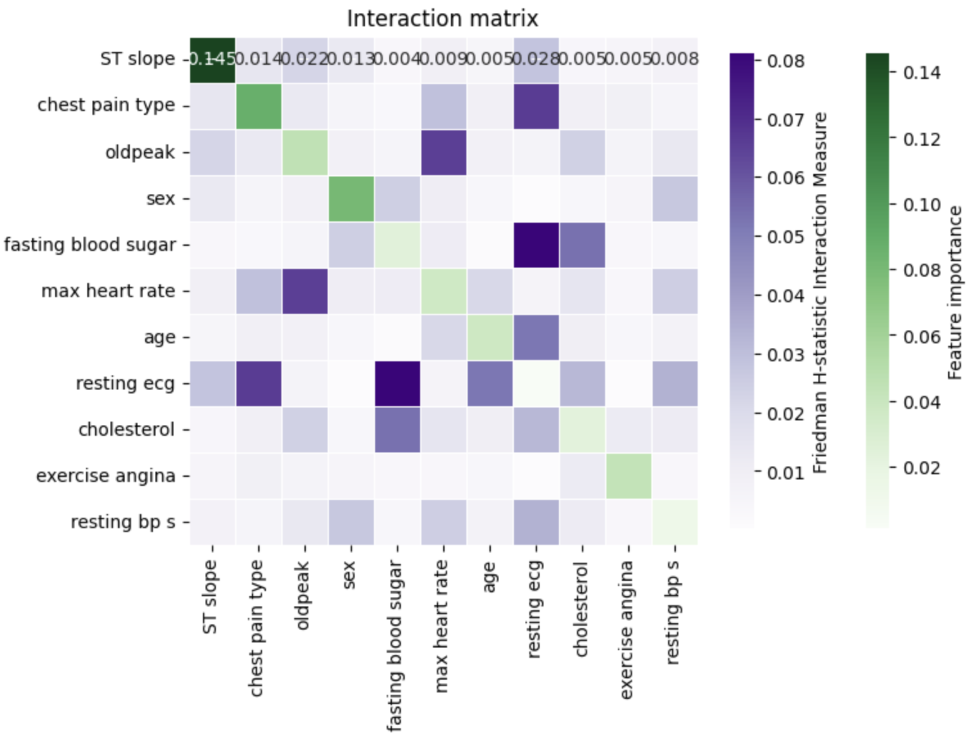
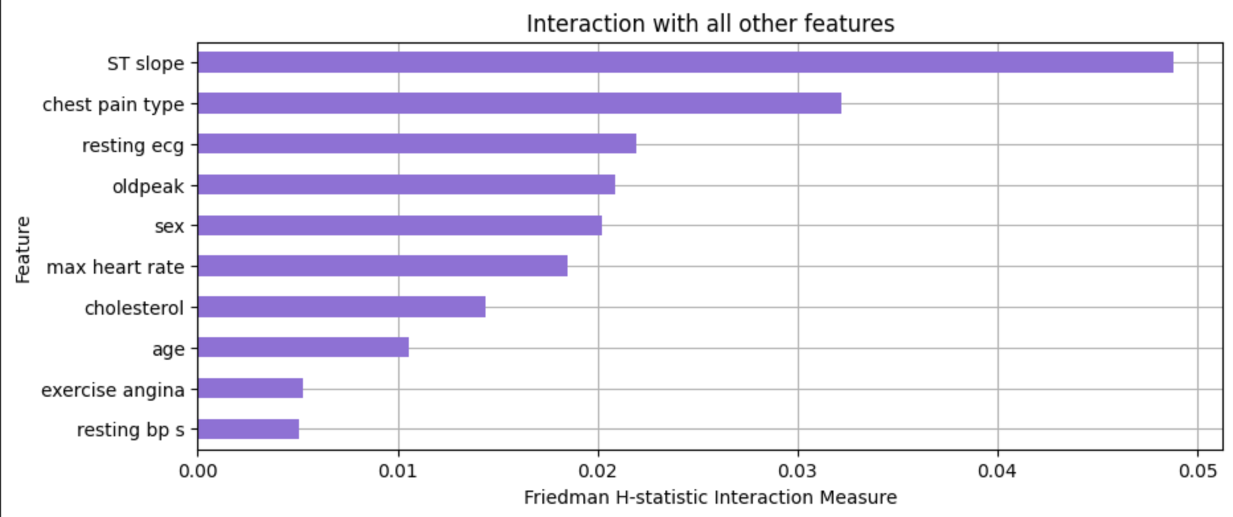
H-Statistic
(Bar Chart): (Interaction Matrix):

Slide 32
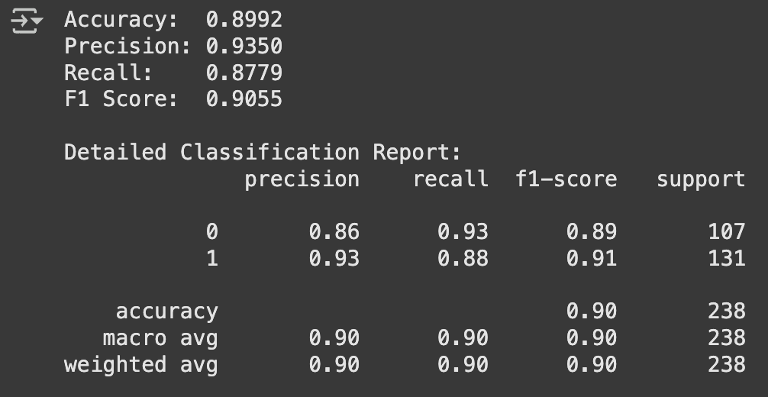
5- Decision Tree

Slide 33
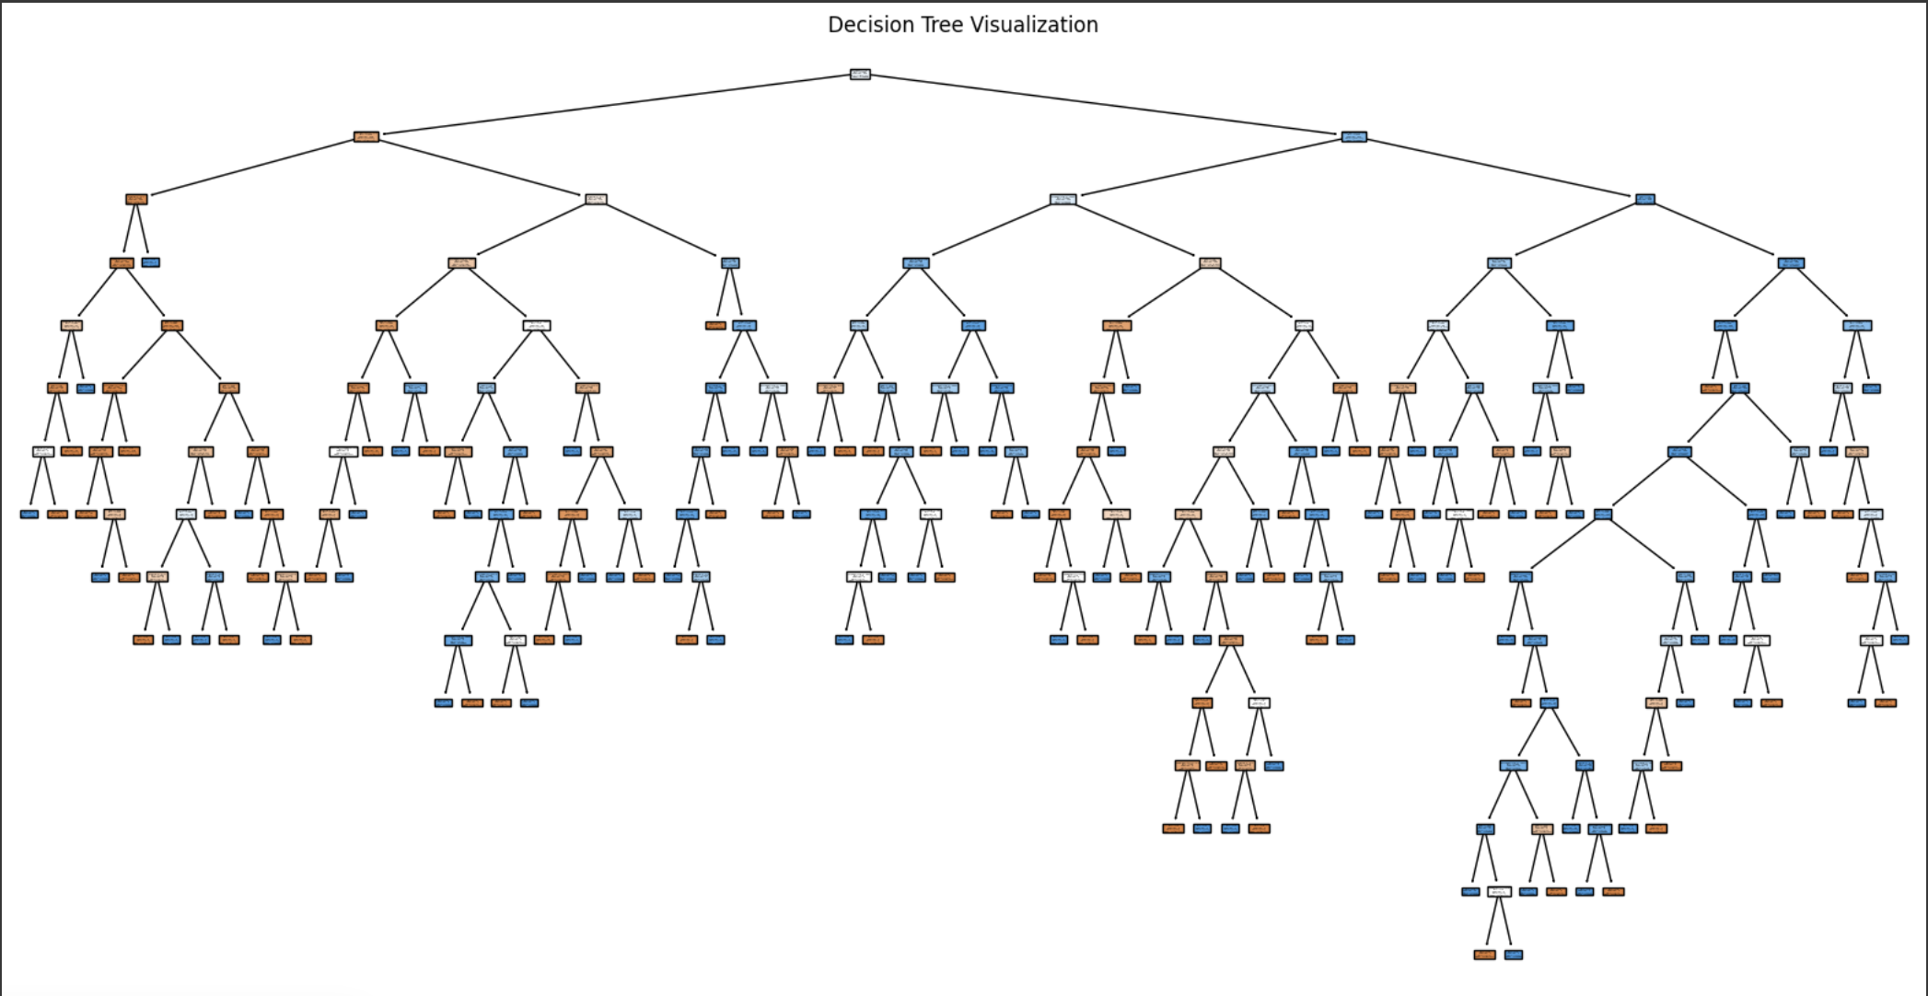
Global Surrogate Model:

Slide 34
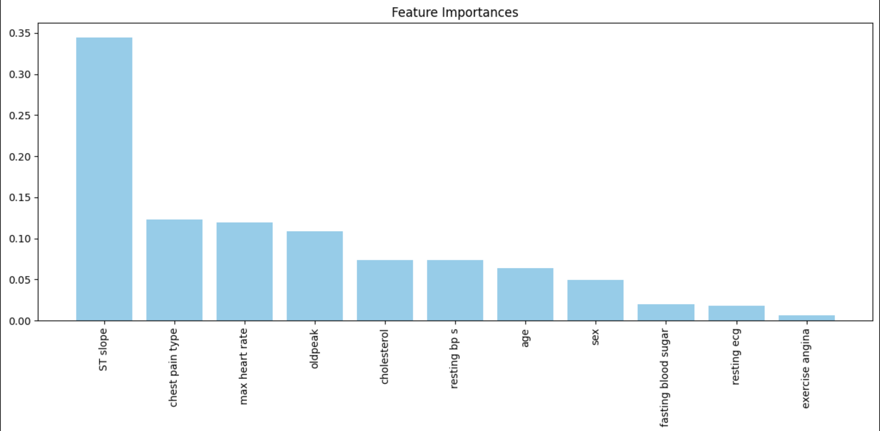
Feature Importance:

Slide 35
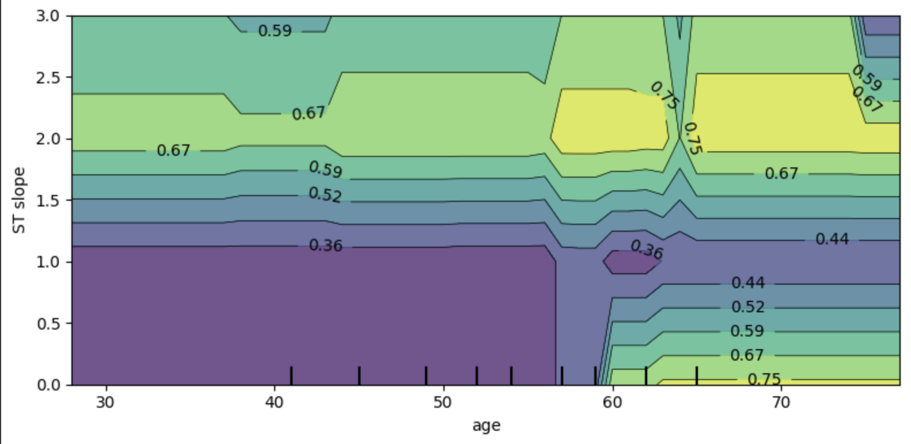
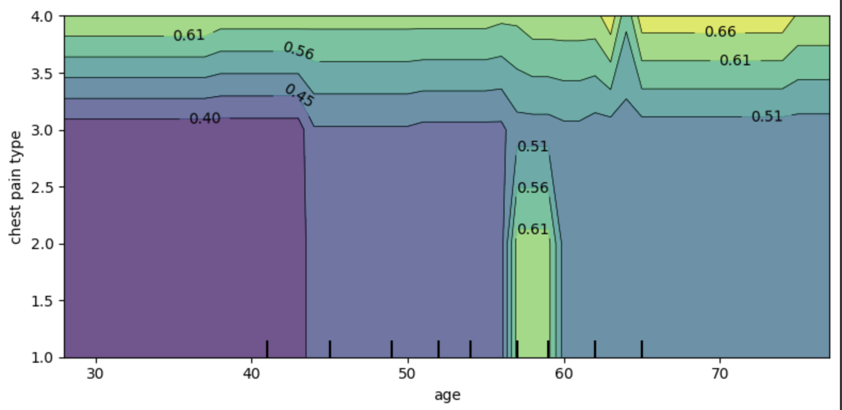
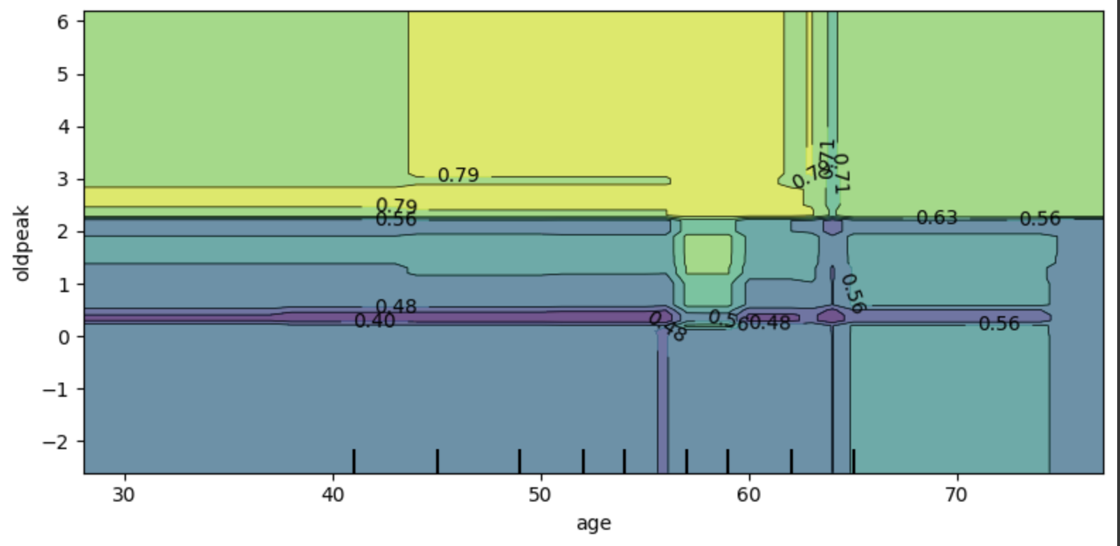
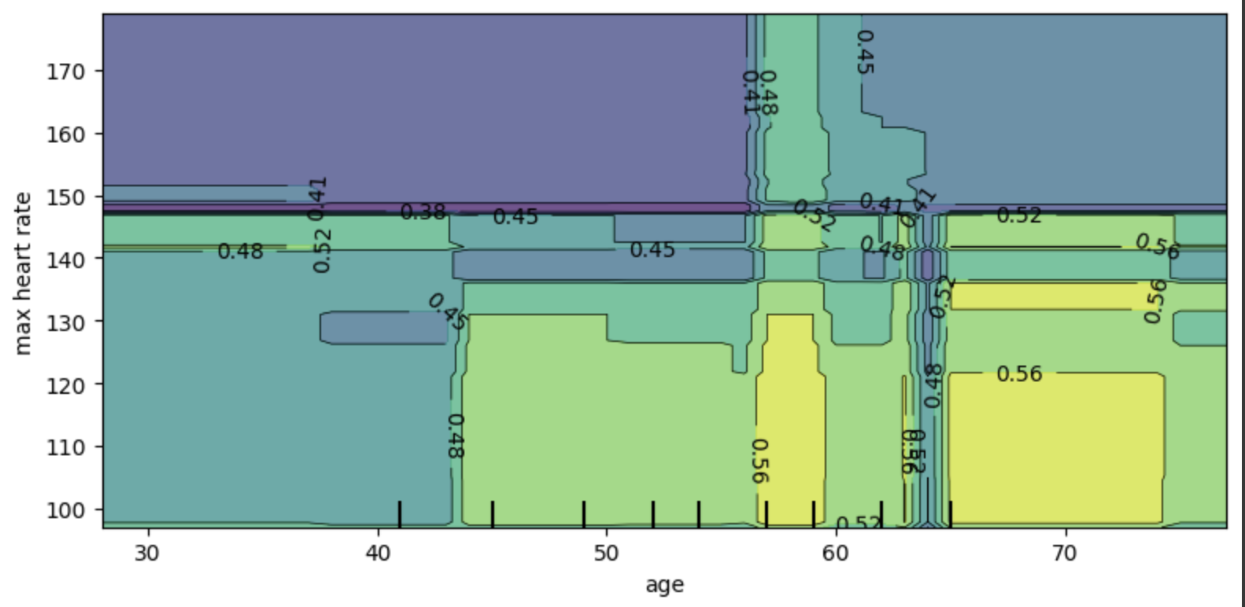
PDP:

Slide 36
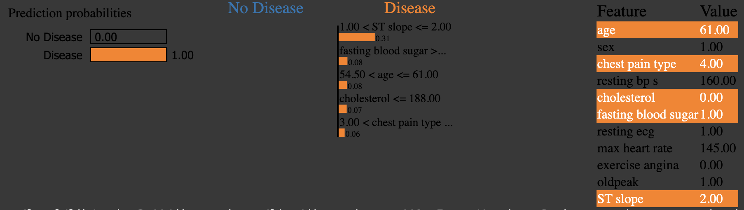


LIME:

Slide 37

6- XGBoost

Slide 38

Feature Importance:

Slide 39

SHAP:

Slide 40



LIME:

Slide 41




PDP:

Slide 42

7- Naive Bayes

Slide 43

PDP:

Slide 44

ICE:

Slide 45

Global Surrogate Model:

Slide 46


LIME:

Slide 47

Feature Importance:

Slide 48

8- Random Forest

Slide 49


LIME:

Slide 50



SHAP:

Slide 51

Pair Plot:

Slide 52

PDP:

Slide 53

LOFO:

Slide 54

Permutation importance:

Slide 55

9- MLP

Slide 56


LIME:

Slide 57



SHAP:

Slide 58

Pair Plot:

Slide 59

PDP:

Slide 60

ICE:

Slide 61
Conclusion
The Random Forest Model achieves the highest accuracy on the dataset with 95%, followed by XGBoost and MLP both with 92%.
The SVC model achieved the lowest accuracy with 78%, but the accuracy became much better when using the SVC with rbf kernel and it reached 88%

